Slide 1
Exploring Biotechnology
Projections

Slide 2
Lesson 1

Slide 3
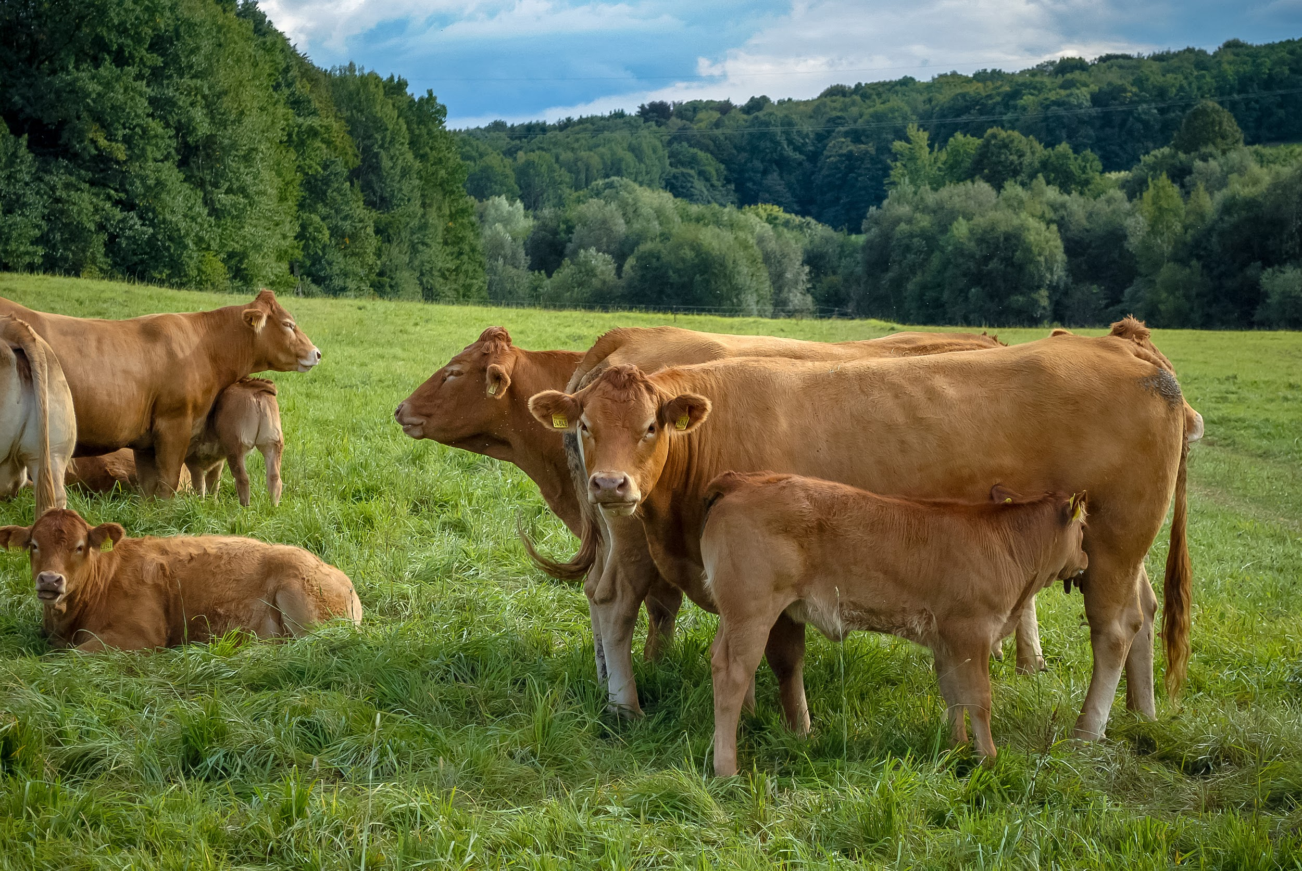
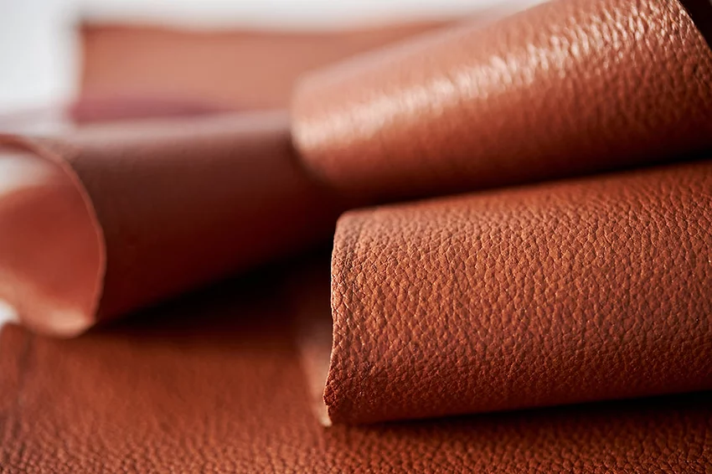
1.1 - Warm-Up
Leather is made from cow skins. Cows are a major contributor to climate change.
A company called VitroLabs in San Jose is developing a way to grow leather in a lab, without killing any cows.
What do you think about this?
What does it make you wonder?
What questions do you have?
Cows are raised so their skin can be used to make leather
© 2022 by The Regents of the University of California.
Lab-grown Leather. Image Courtesy of VitroLabs Inc, © 2021

Slide 4
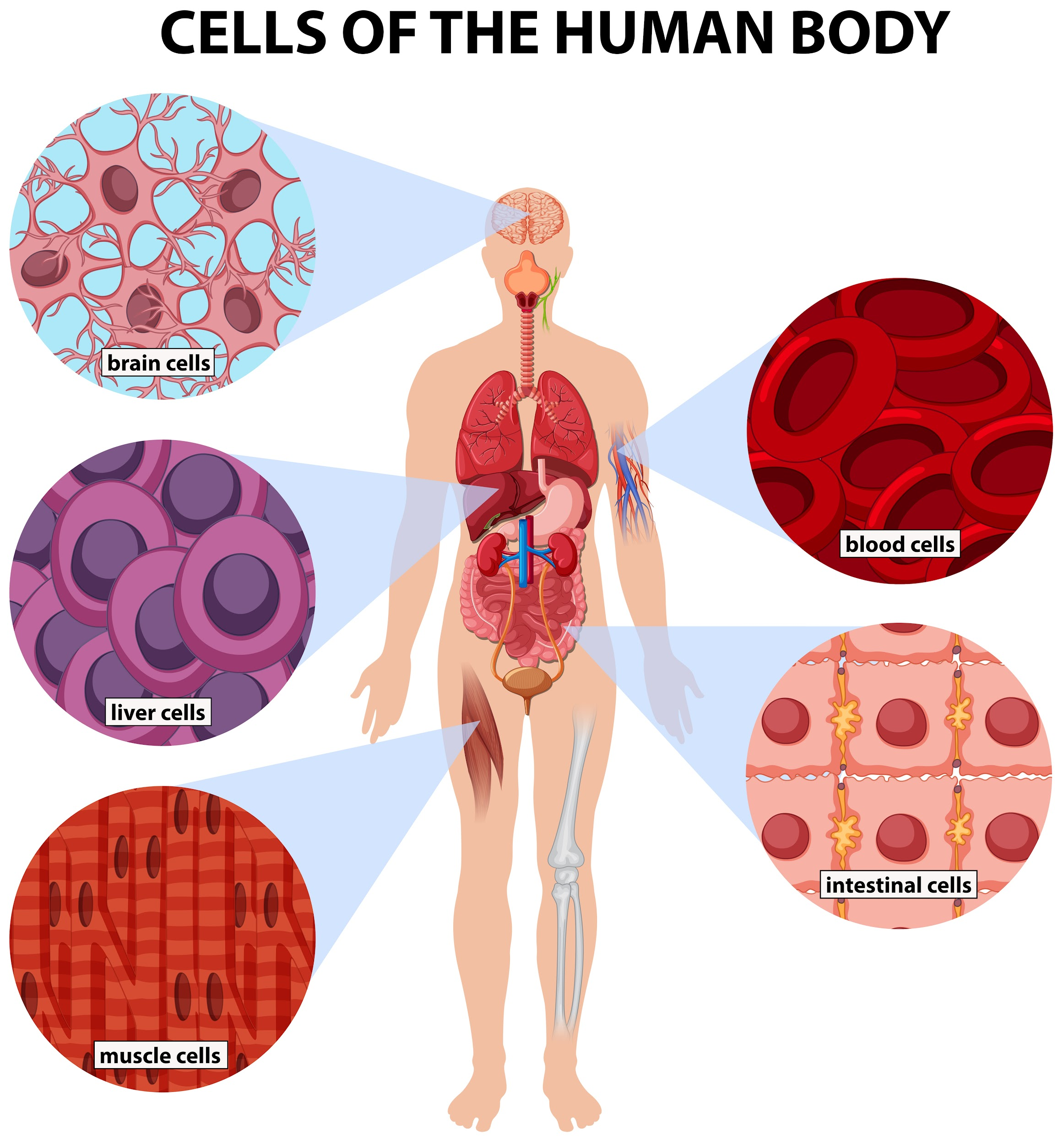
1.2A - Cells
Cell: the smallest unit that can live on its own and that makes up all living organisms and the tissues of the body.
Humans have many different kinds of cells
© 2022 by The Regents of the University of California.

Slide 5
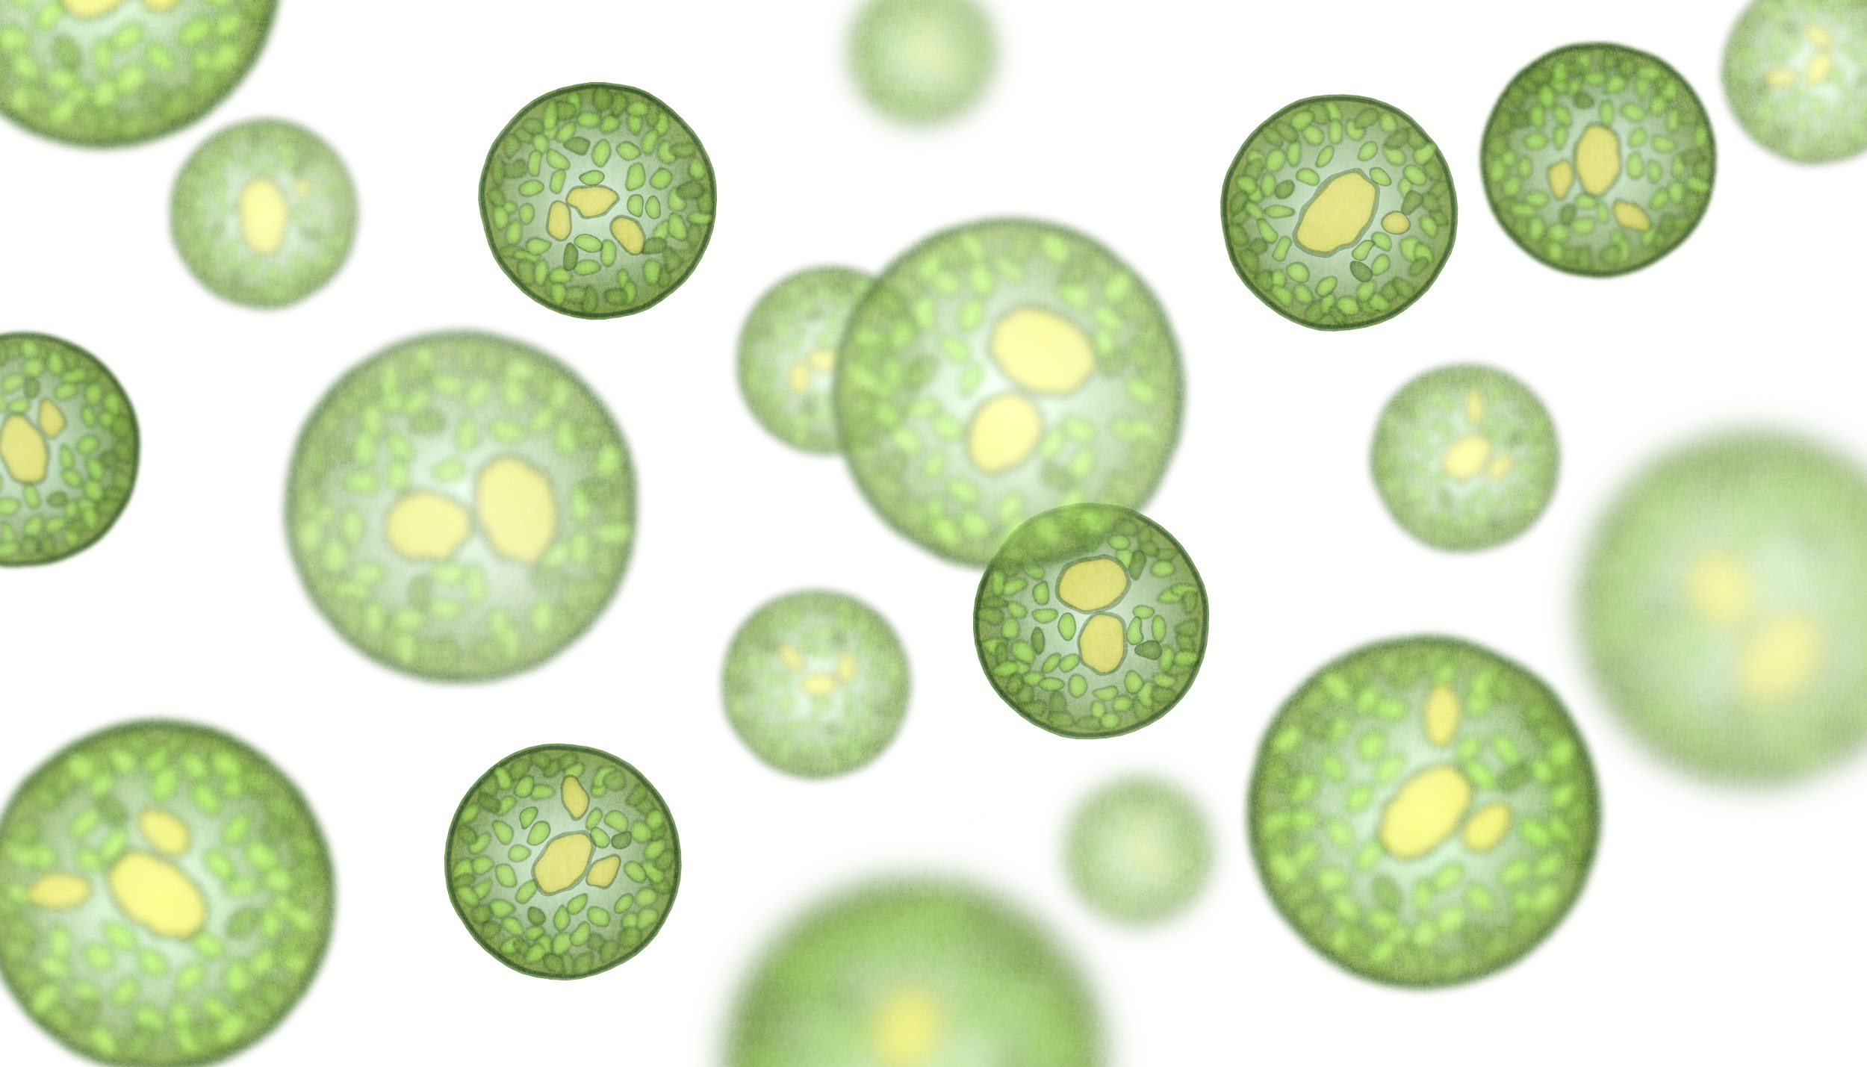
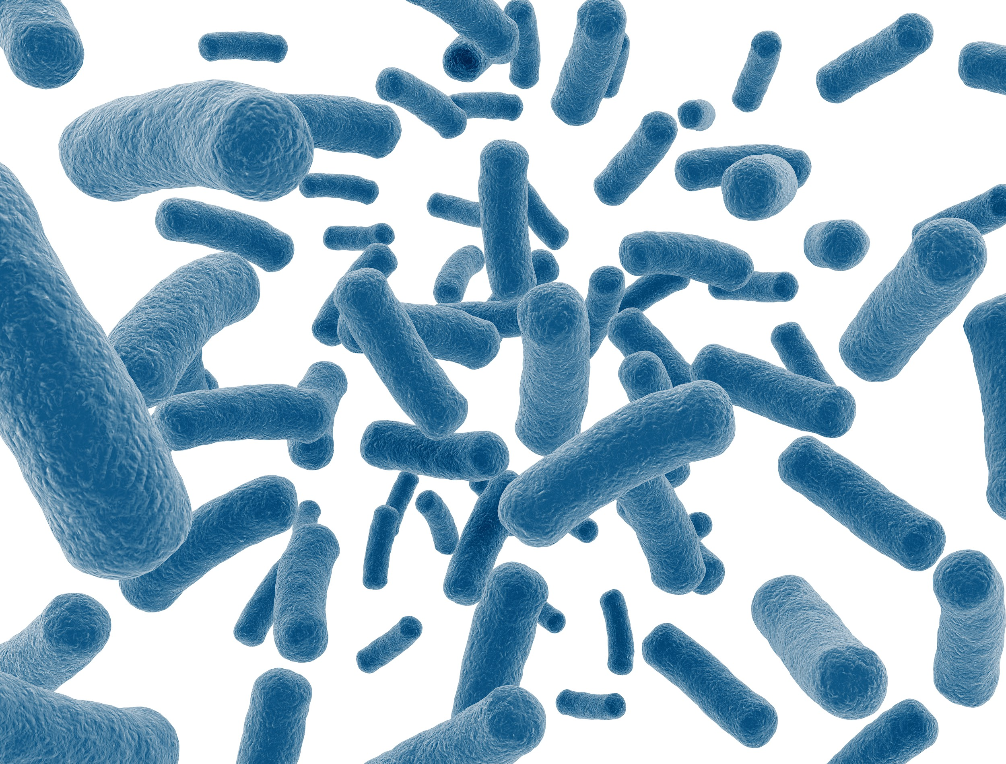
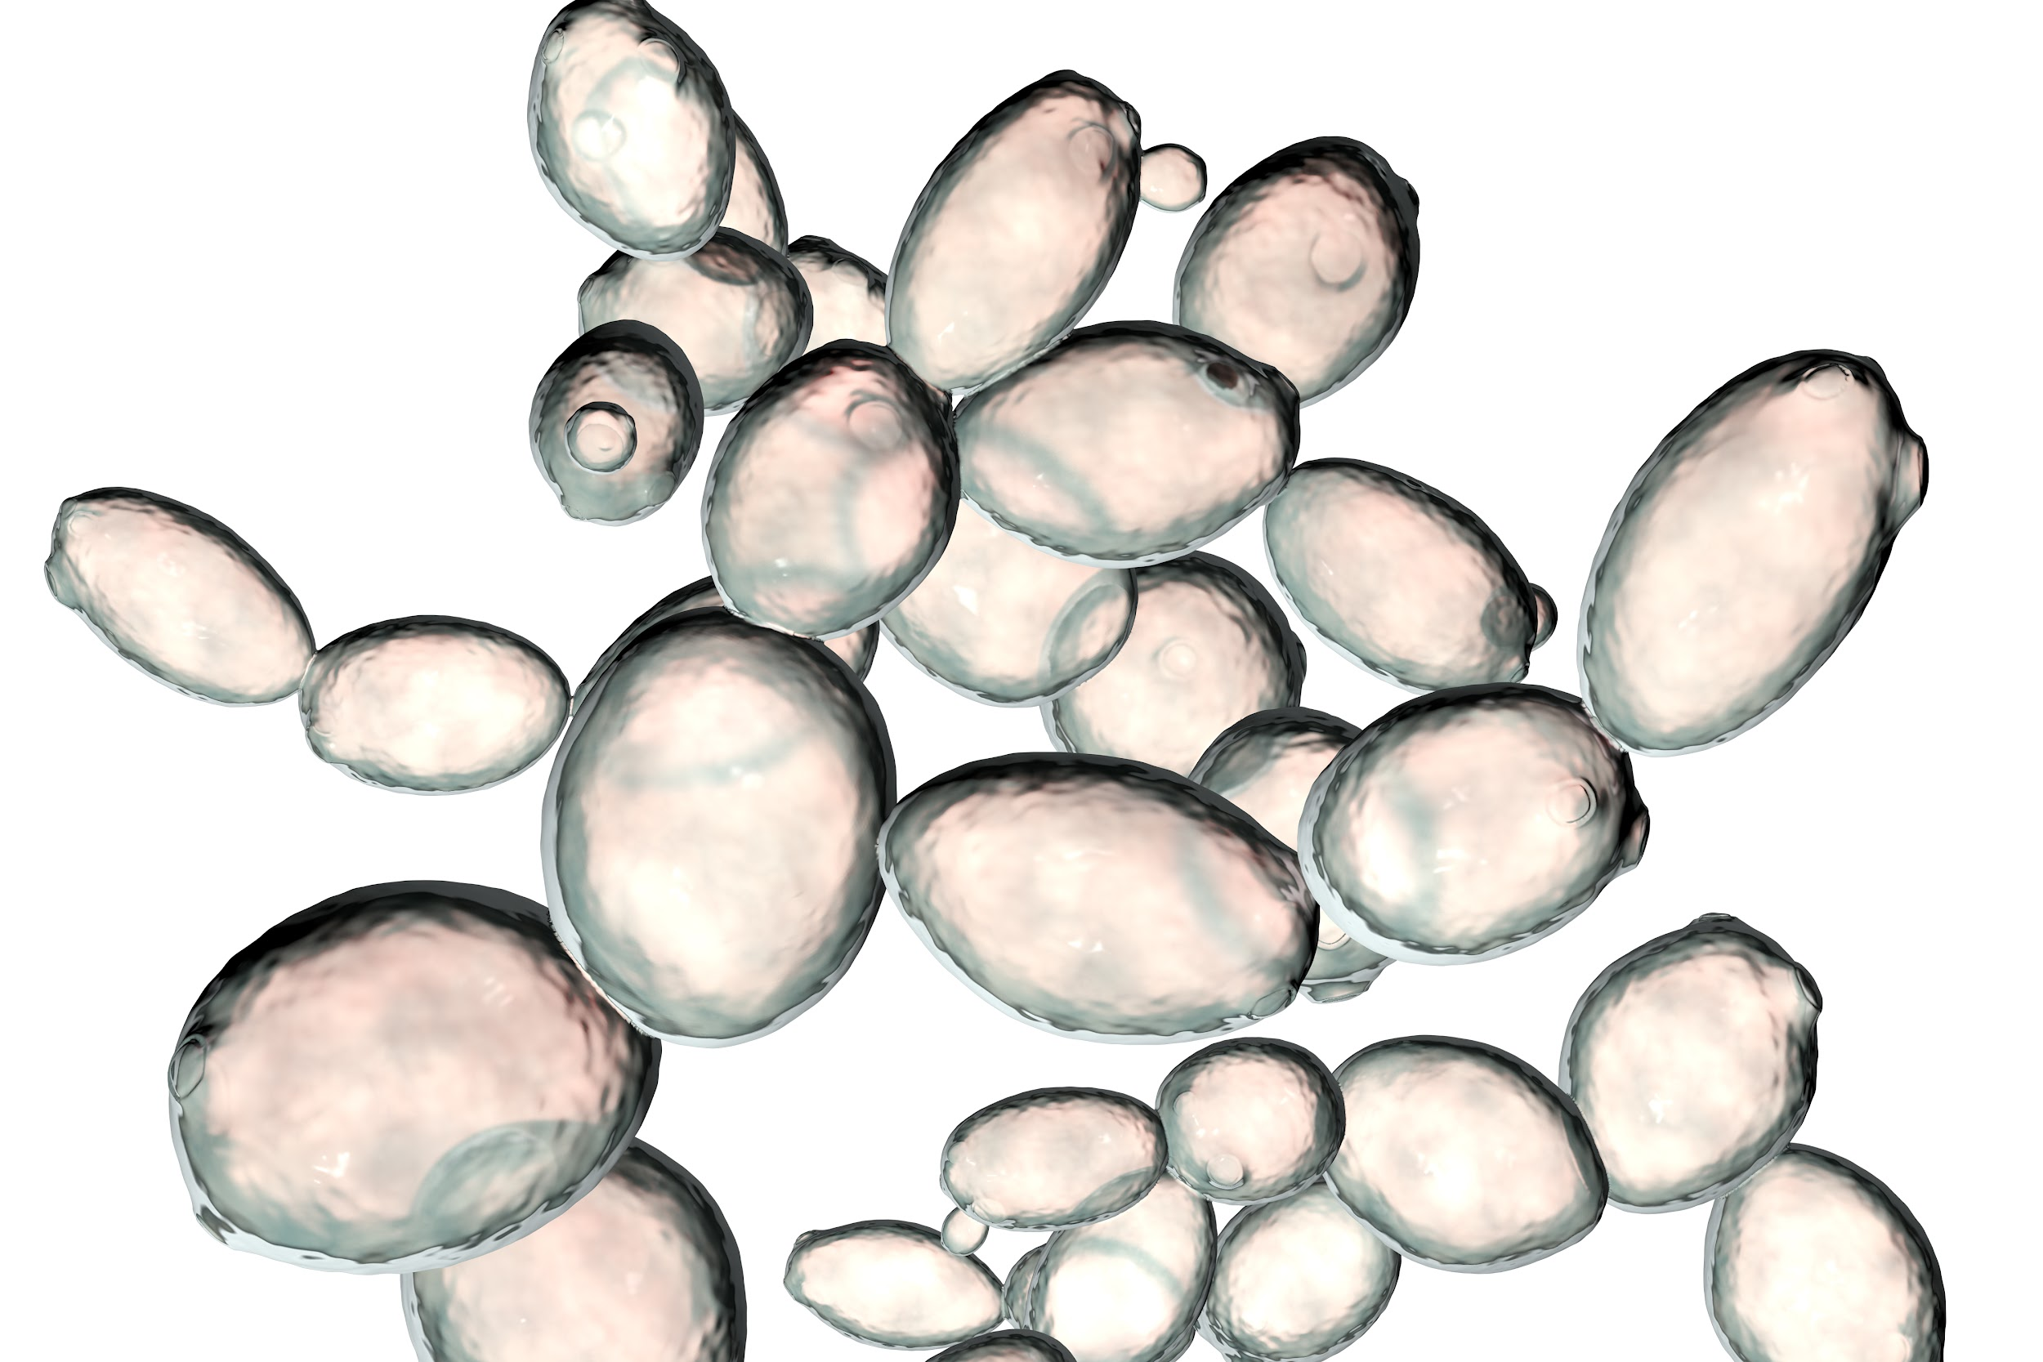
1.2B - Microbes
Microbes: tiny organisms that are made of just one kind of cell. Each individual organism is too small to be seen without a microscope.
Algae cells
Yeast cells
Bacteria cells
© 2022 by The Regents of the University of California.

Slide 6

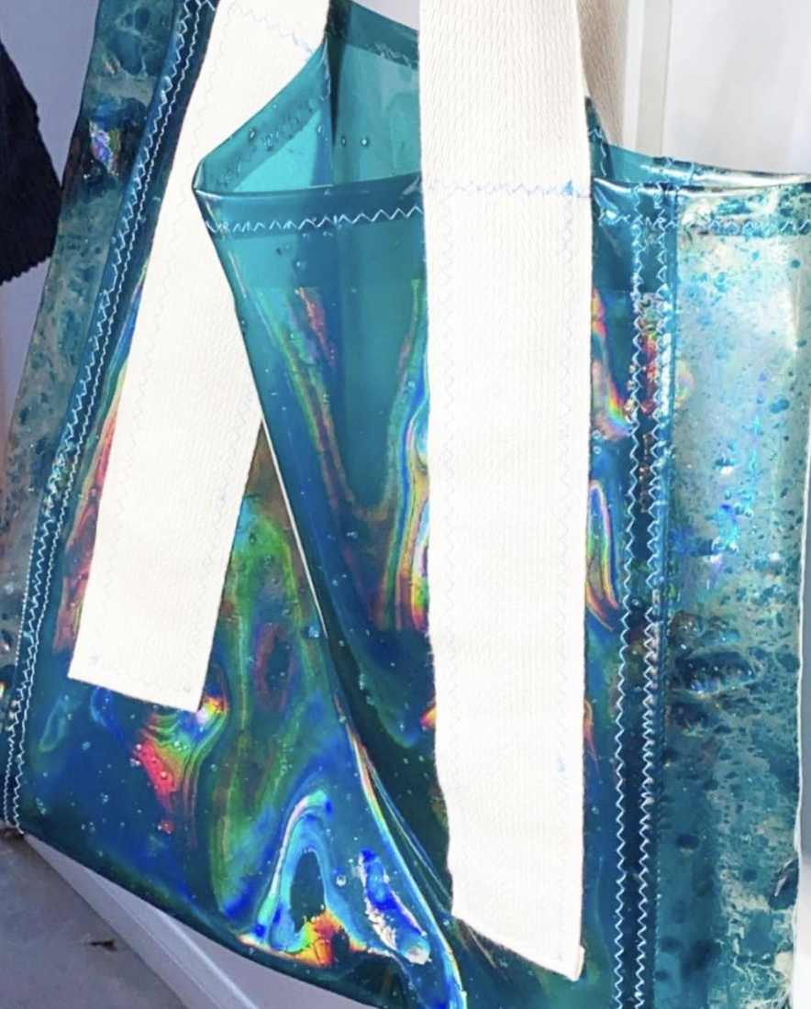
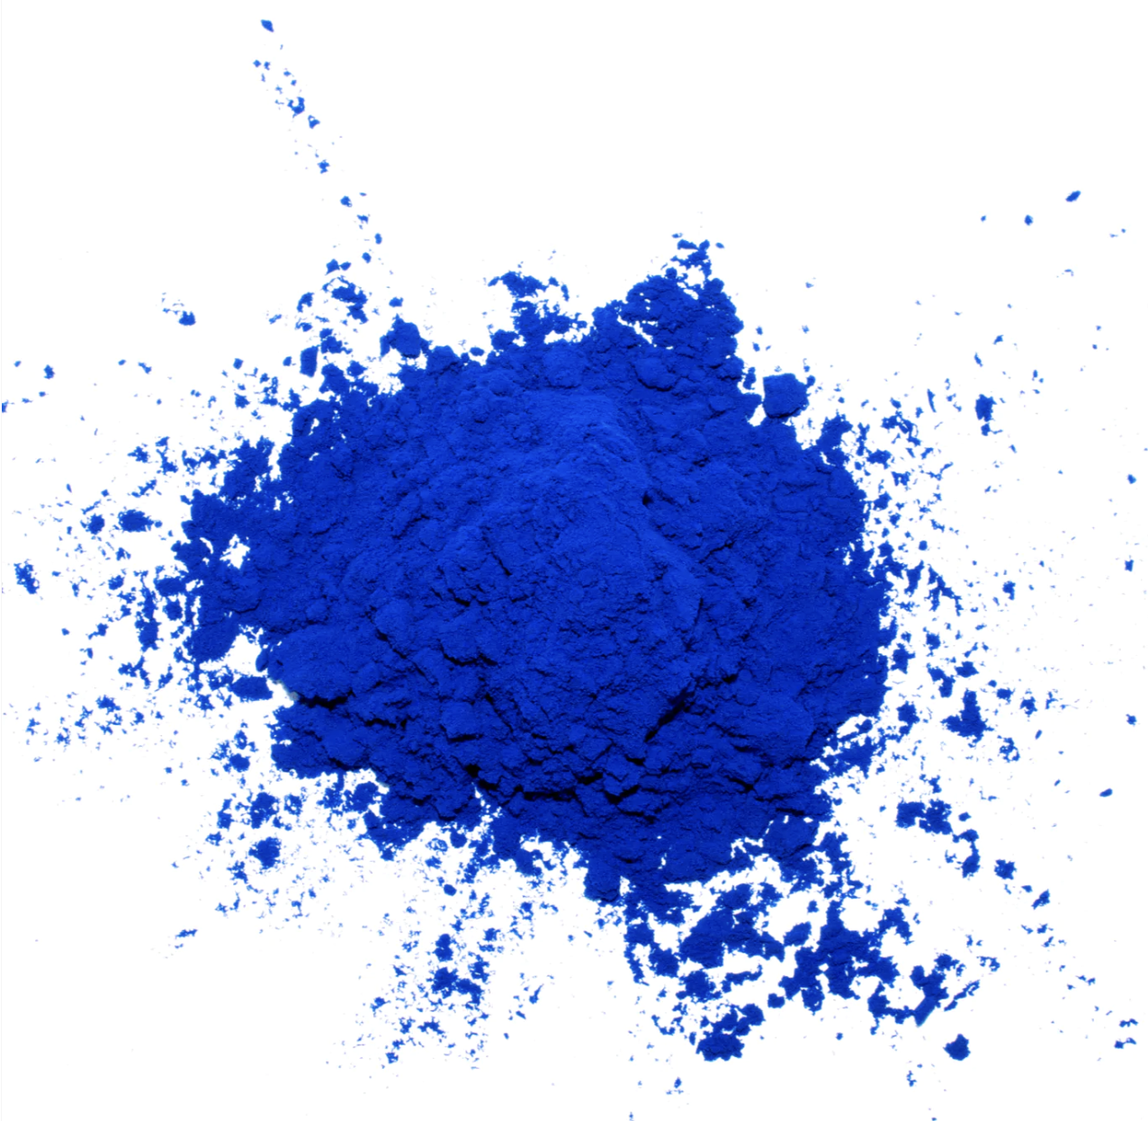
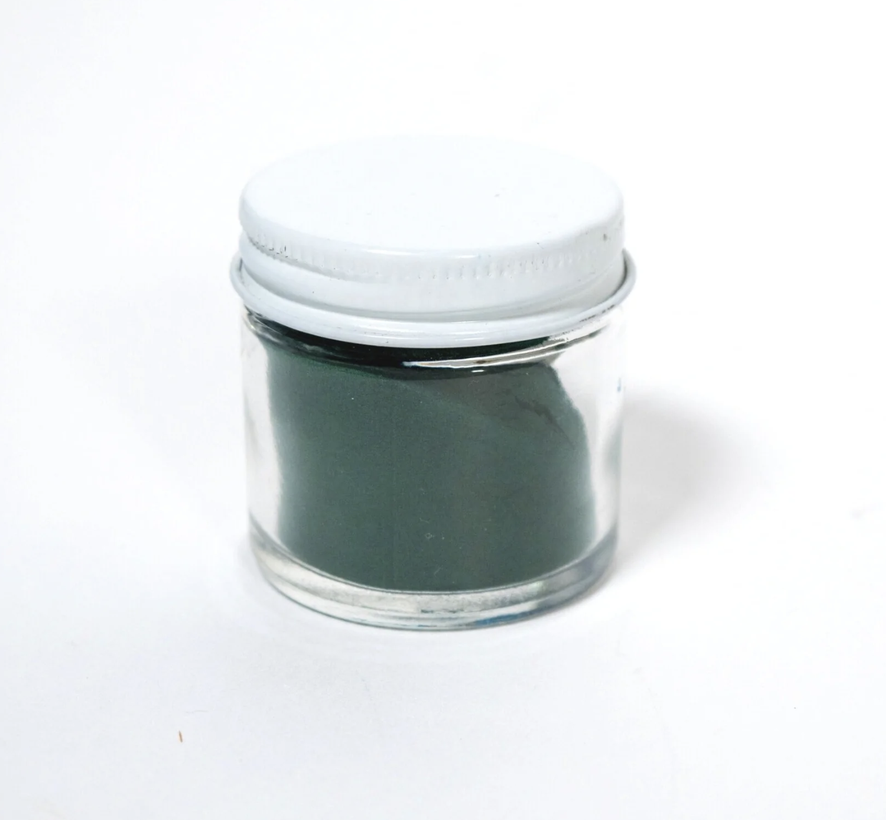
1.2C Microbes can make: Dyes & Pigments
Company: Spira Inc.
Location: Los Angeles, CA
Summary: Spira makes products from algae. When algae grow, they remove carbon dioxide from the atmosphere, which is why Spira describes its products as “carbon negative.
Bioplastic purse made with Spira pigments, by Sasha Fishman & Maddy Lyon
© 2022 by The Regents of the University of California.
Notes:
Most dyes and pigments are made from petroleum or coal and thus contribute to climate change.

Slide 7

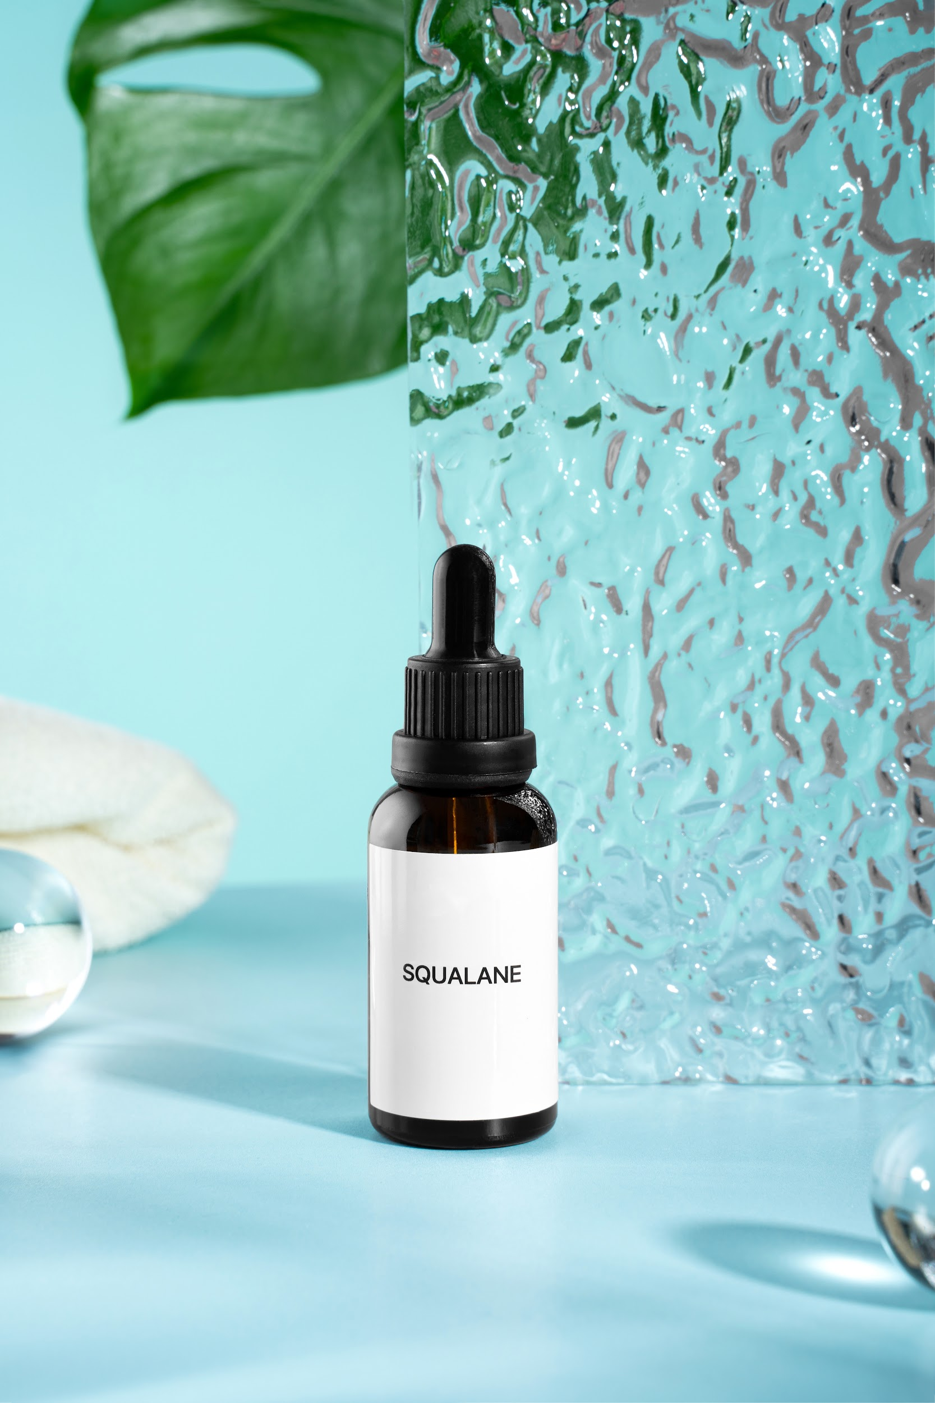
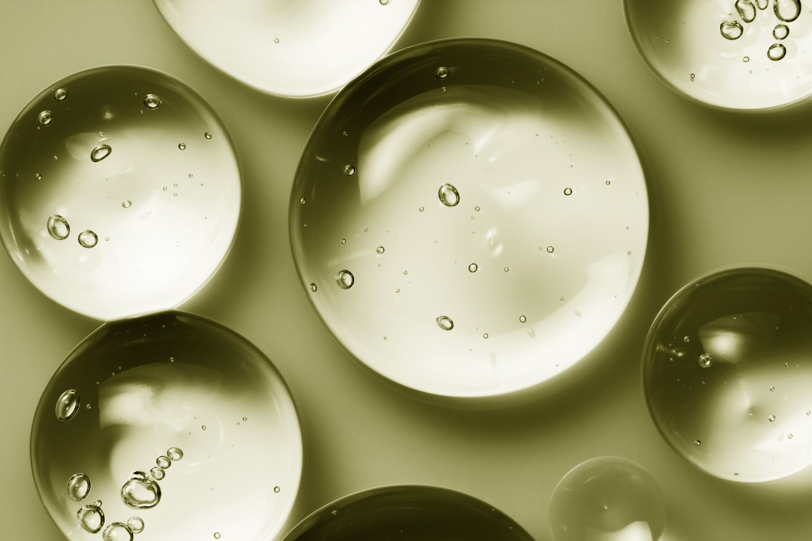
1.2D Microbes can make: Moisturizers
Company: Amyris
Location: Emeryville, CA
Summary: Squalane is a key ingredient in specialty moisturizers and is normally harvested from shark livers. Amyris engineered a kind of yeast to make it instead.
© 2022 by The Regents of the University of California.
Notes:
Sharks play an important role in marine ecosystems, and many shark species are threatened with extinction. Amyris has many different beauty and health products marketed under different brands.

Slide 8

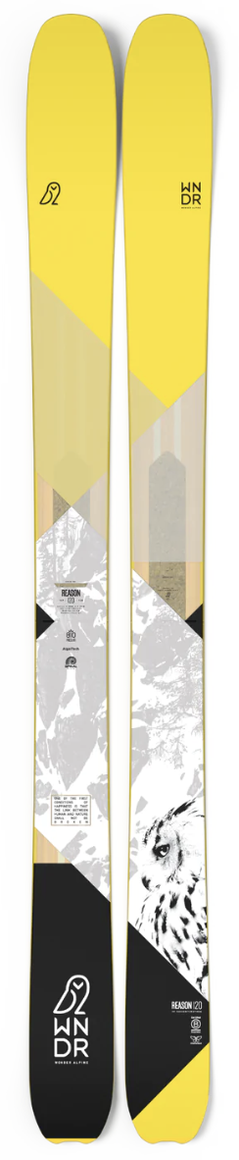
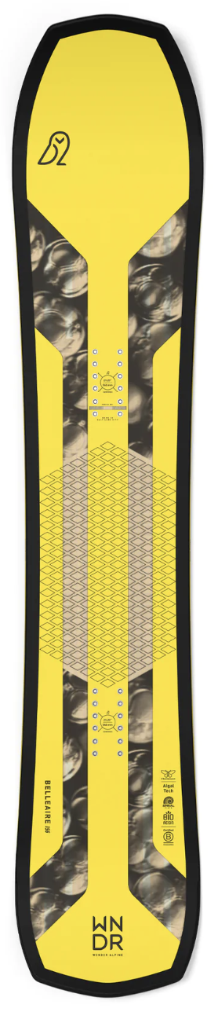
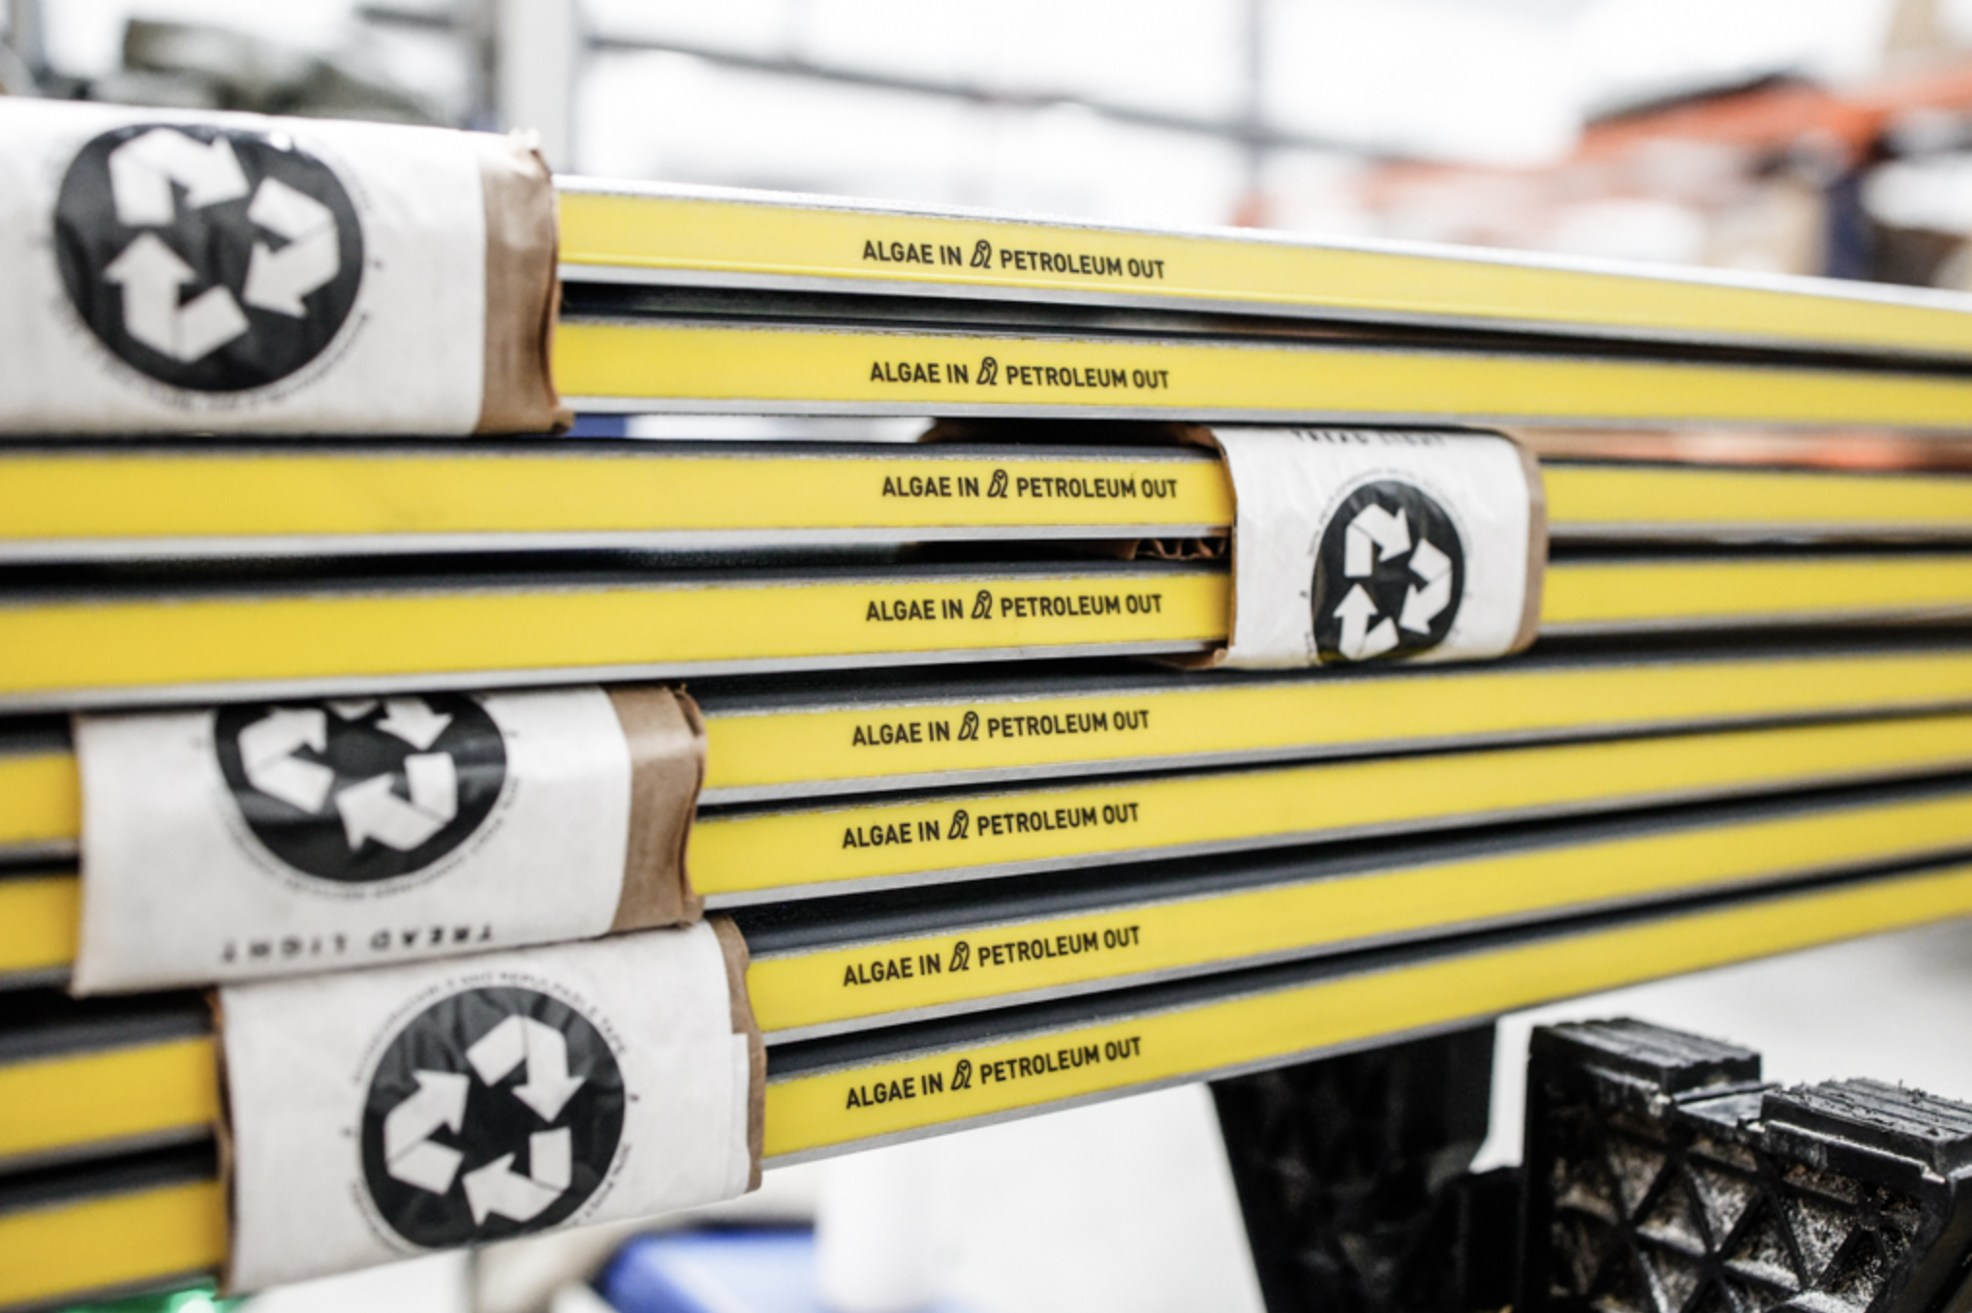
1.2E Microbes can make: Sports Equipment
Company: Checkerspot
Location: Alameda, CA
Summary: Checkerspot and its partner company WNDR Alpine turn oil from algae into a substance called polyurethane that can be used on the insides of skis and snowboards.
© 2022 by The Regents of the University of California.
Notes:
While it is not clear that polyurethane made from algae oil is more sustainable than traditional methods, developing processes for making materials from algae could help transition the economy away from the use of fossil fuels.Polyurethane is one of the most widely used materials in the world. It has applications in areas ranging from medical devices to clothing to appliances to cars.

Slide 9

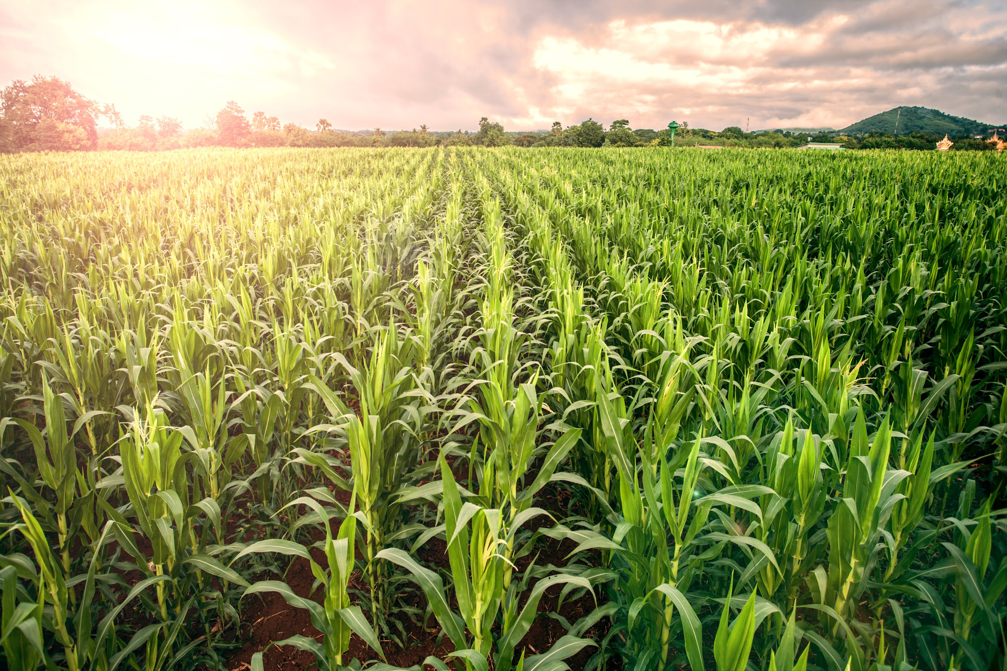
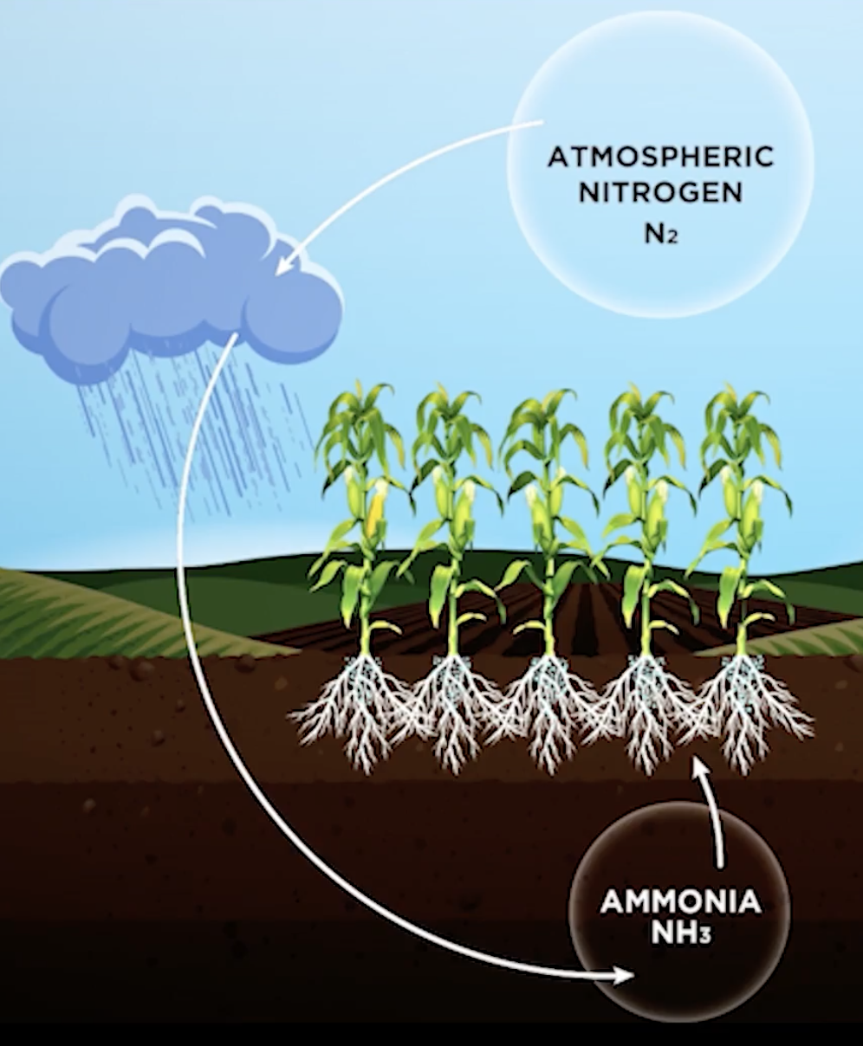
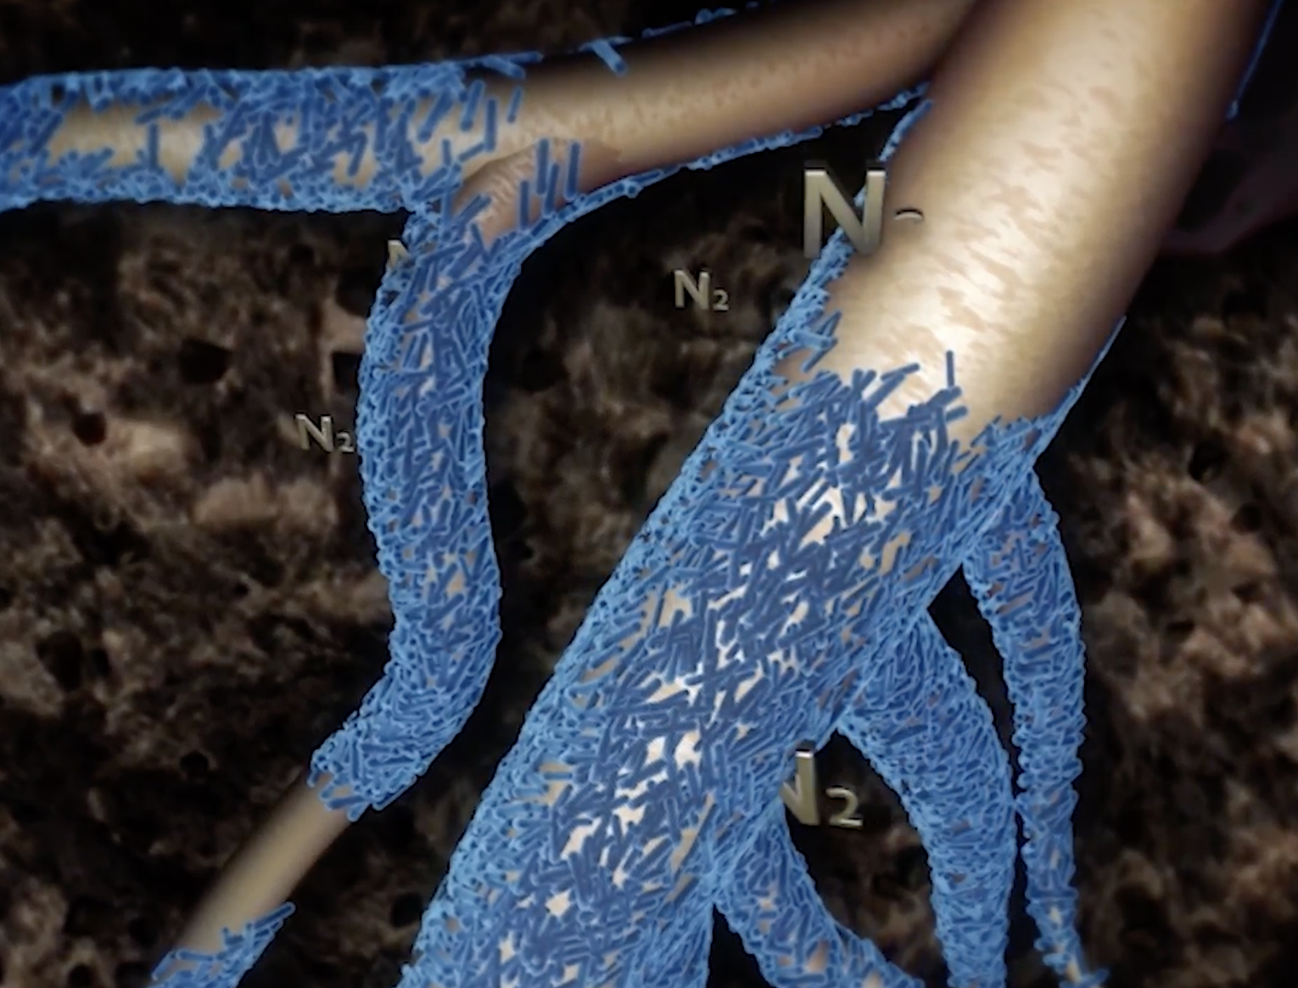
1.2F Microbes can make: Fertilizer
Company: Pivot Bio
Location: Berkeley, CA
Summary: Pivot Bio engineers special bacteria that can turn nitrogen from the air into fertilizer directly in the soil. This allows farmers to grow crops without applying energy-intensive chemical fertilizers.
© 2022 by The Regents of the University of California.
Notes:
Chemical fertilizers are often over-applied to fields, which leads to huge algae blooms and “dead zones” when they are rinsed into lakes and seas. Making fertilizer in soil could avoid this problem. Producing chemical fertilizers is a very energy intensive process, accounting for 1% of total global energy consumption.

Slide 10

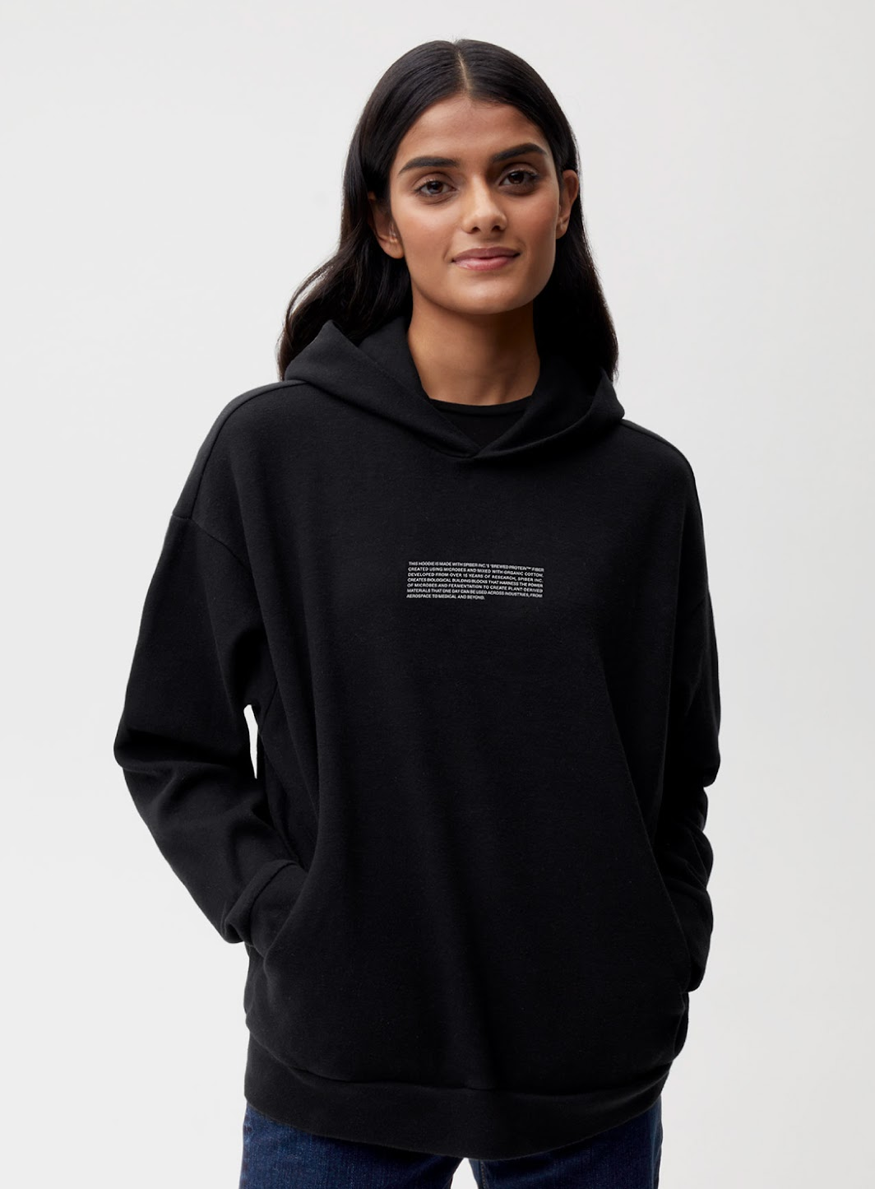
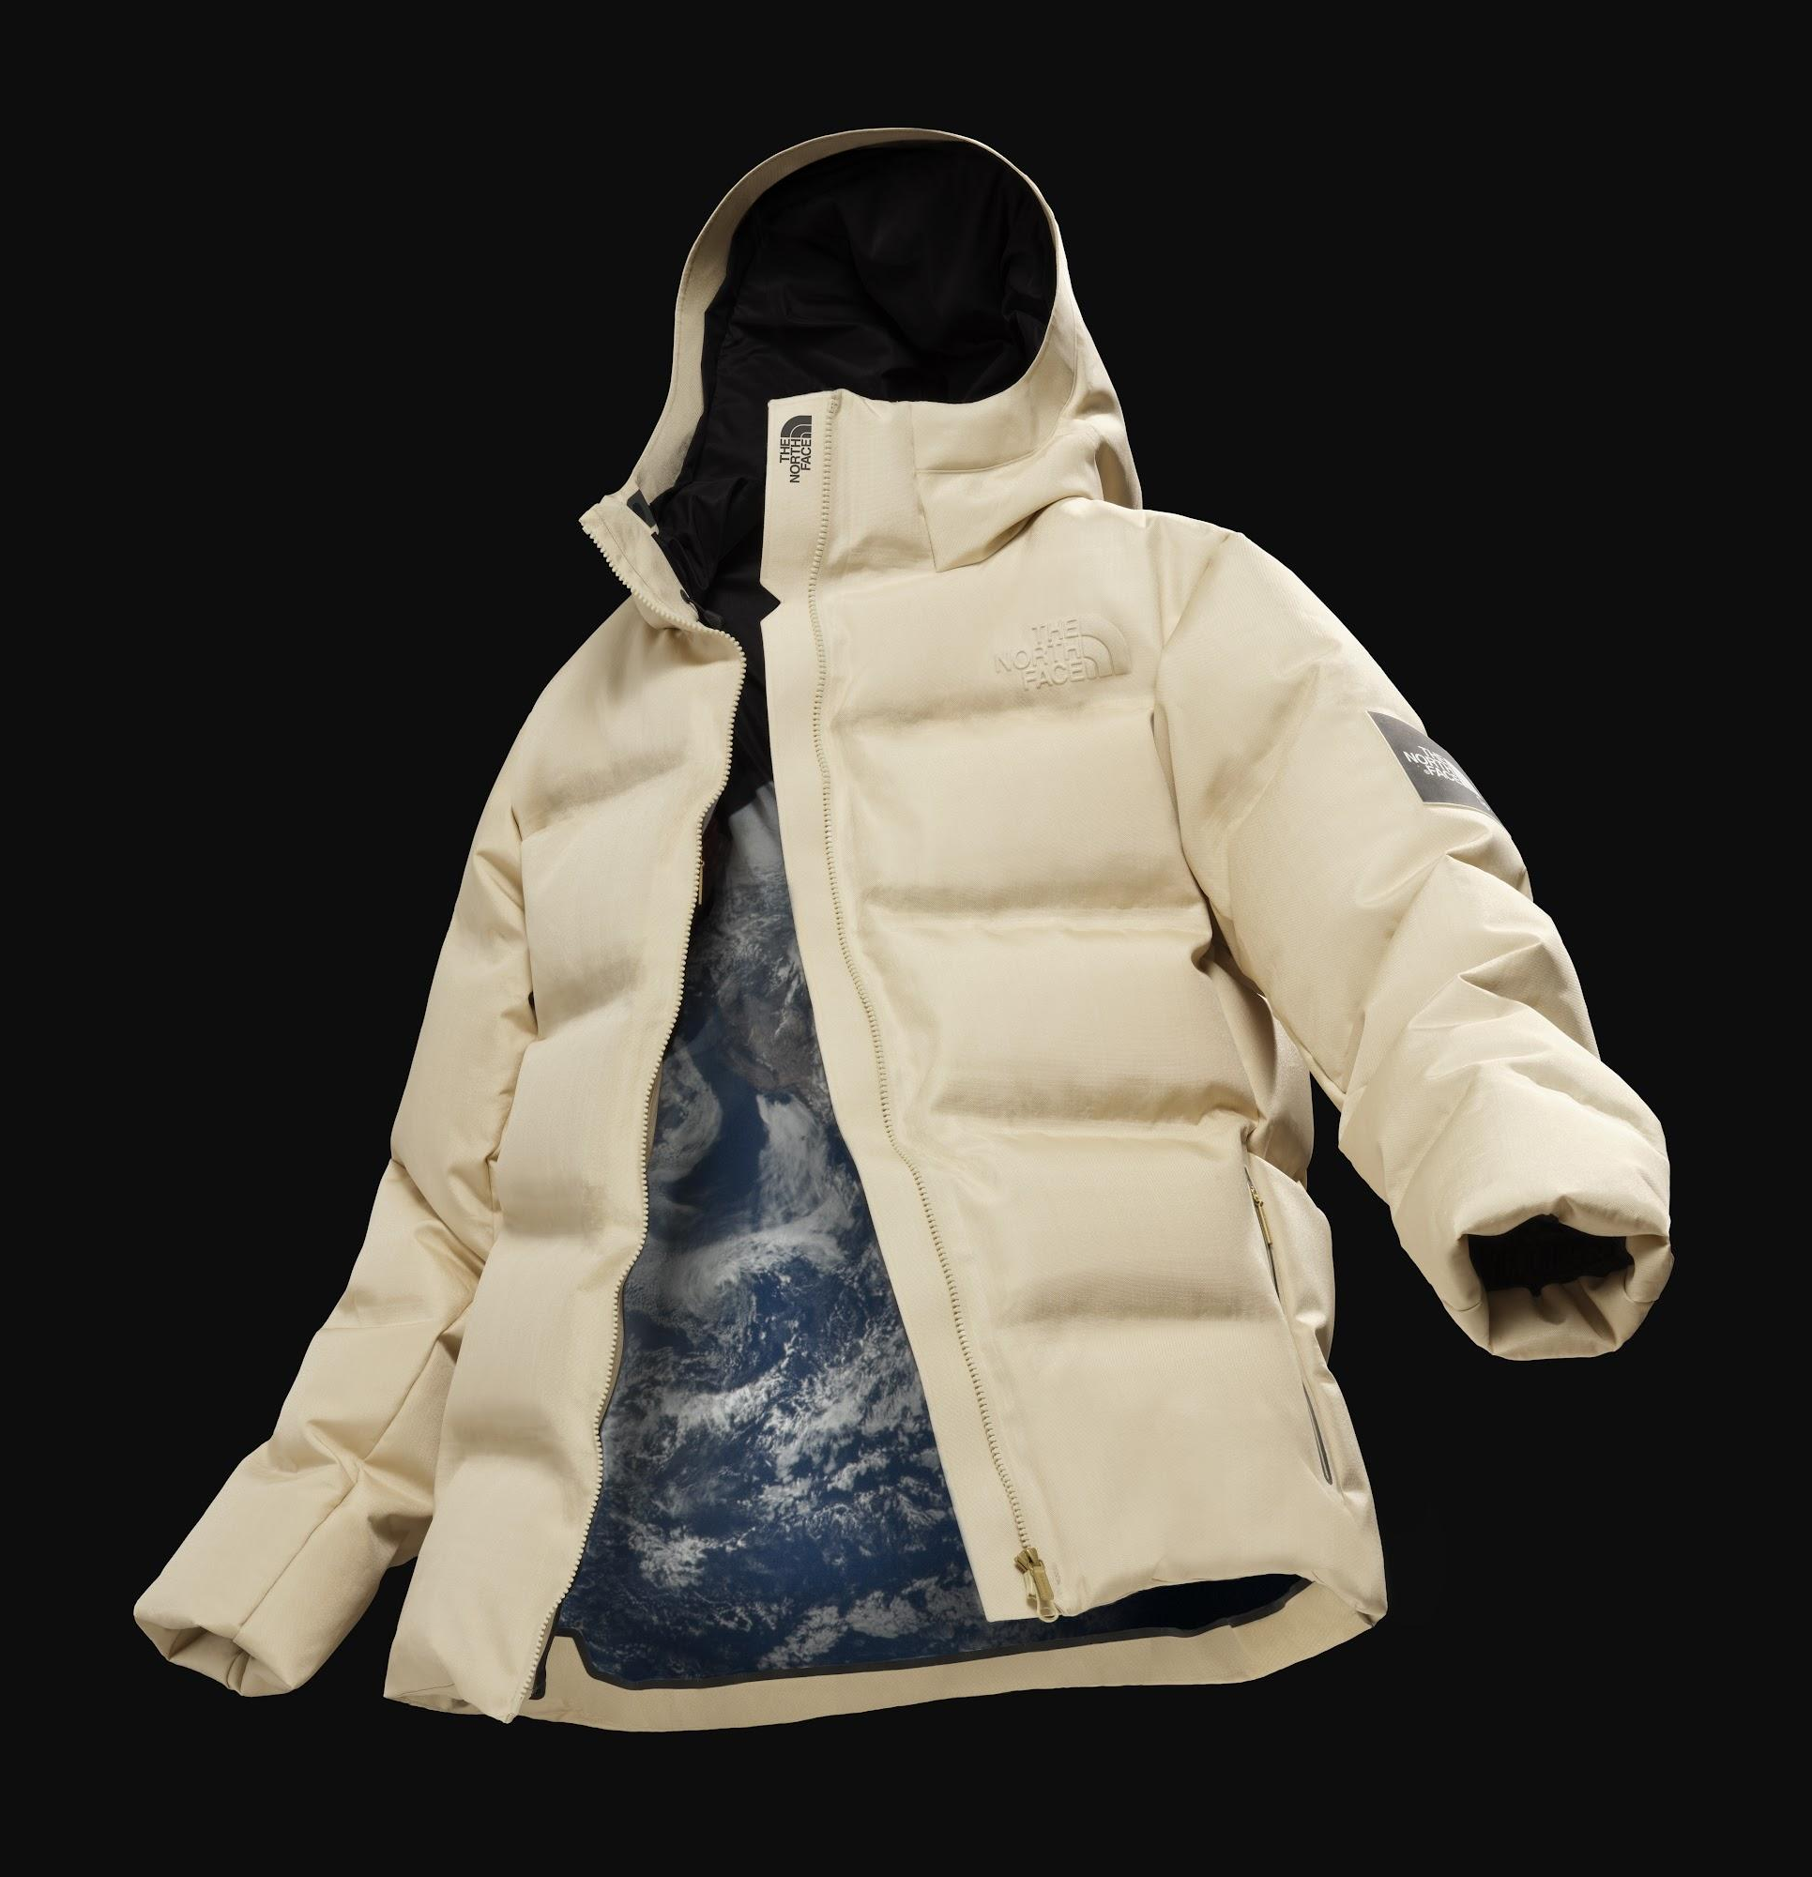
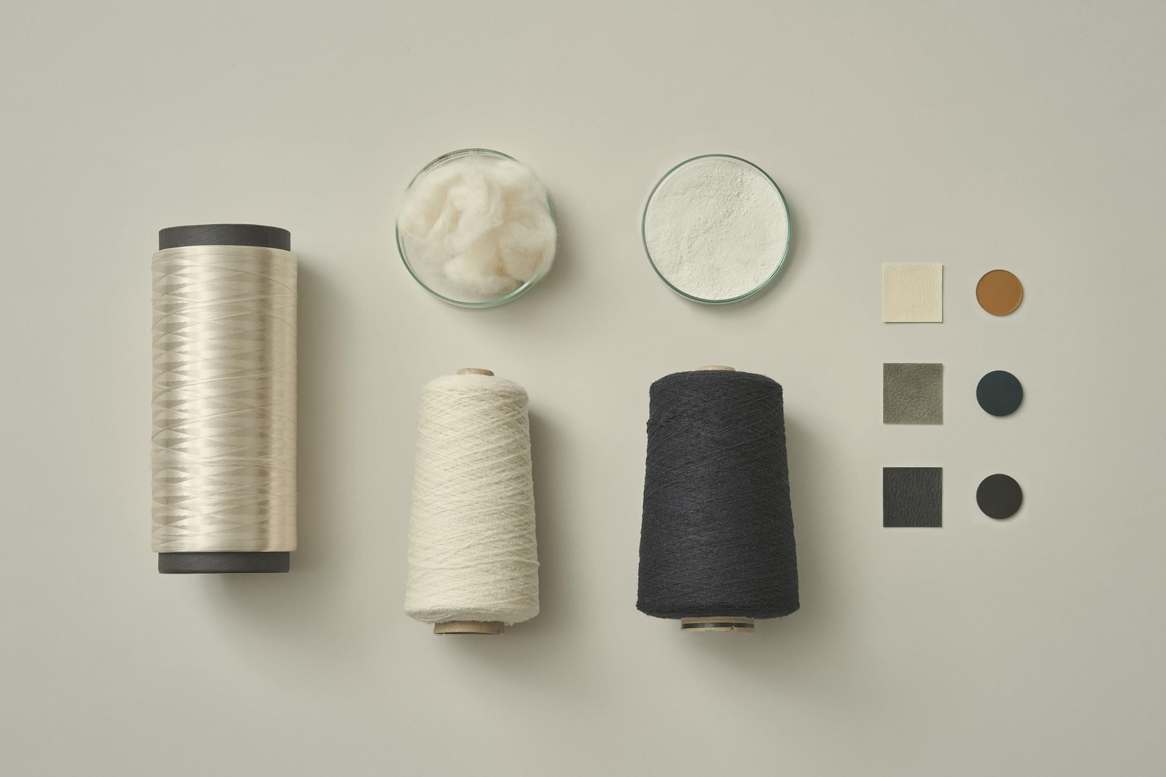
1.2G Microbes can make: Fabrics
Company: Spiber
Location: Yamagata, Japan
Summary: Spiber engineers yeast and bacteria that can produce spider silk proteins for specialty fabrics and clothing.
© 2022 by The Regents of the University of California.
Notes:
Spider silk is one of the strongest materials on the planet–matching the properties of steel and kevlar. There are many other possible applications for this synthetic spider silk aside from clothing, including artificial tendons or ligaments, surgical thread, contact lenses, and body armor. However, spiders can’t be farmed like silkworms, so there is currently no efficient method of producing large quantities of spider silk.

Slide 11

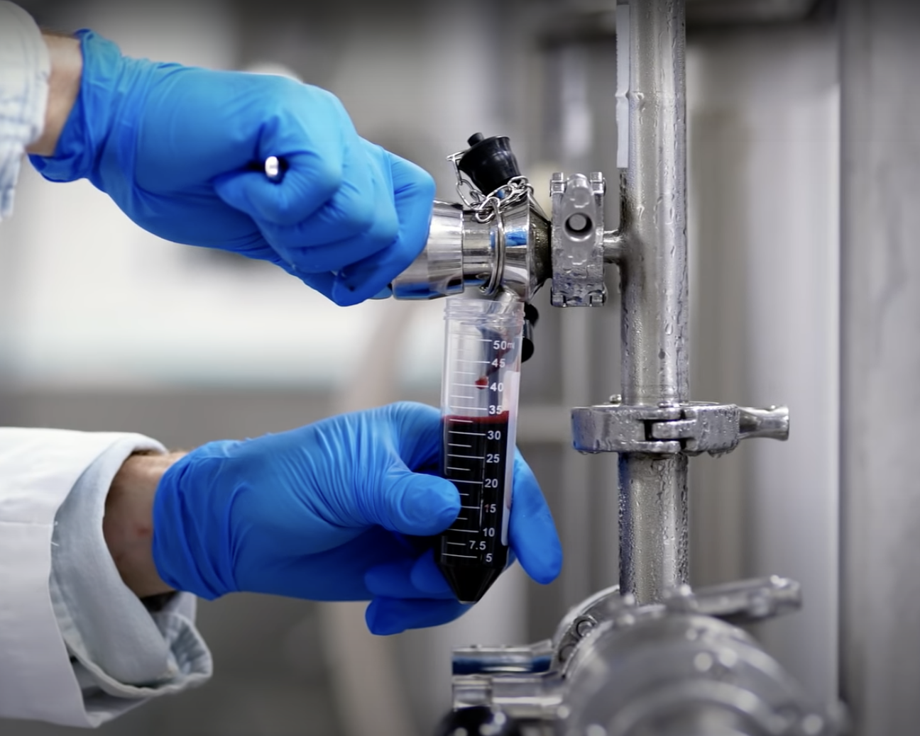
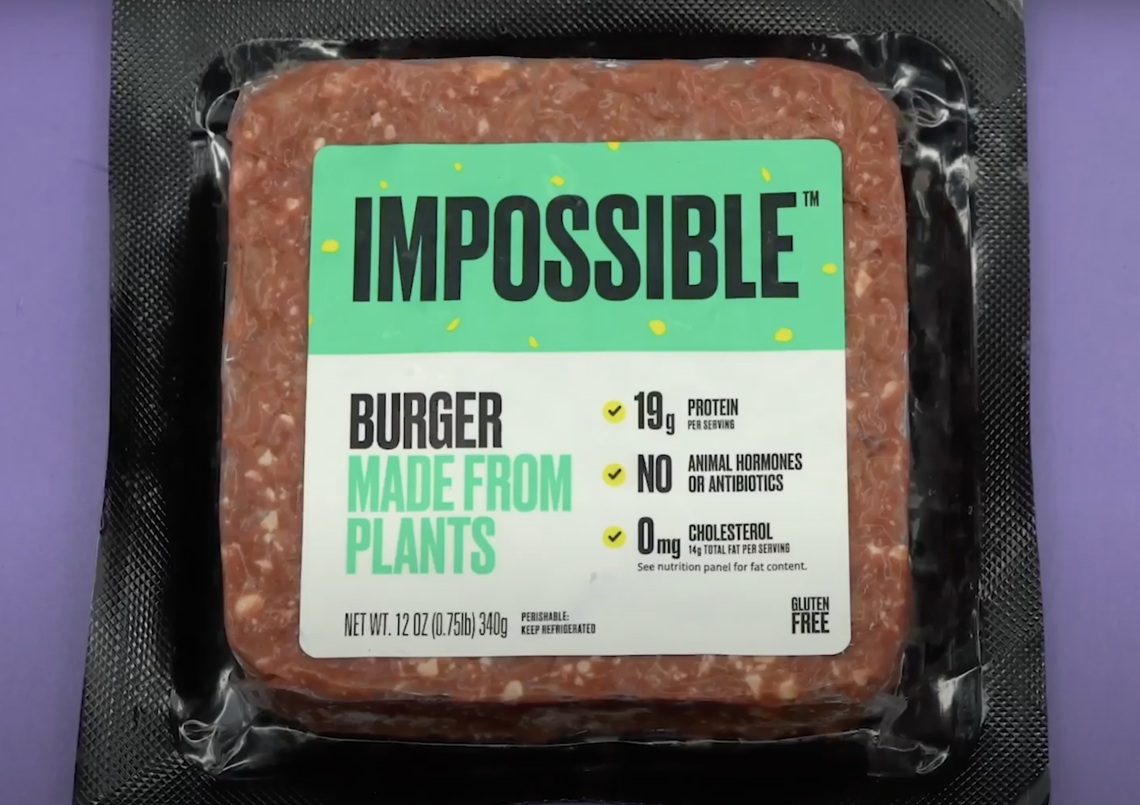
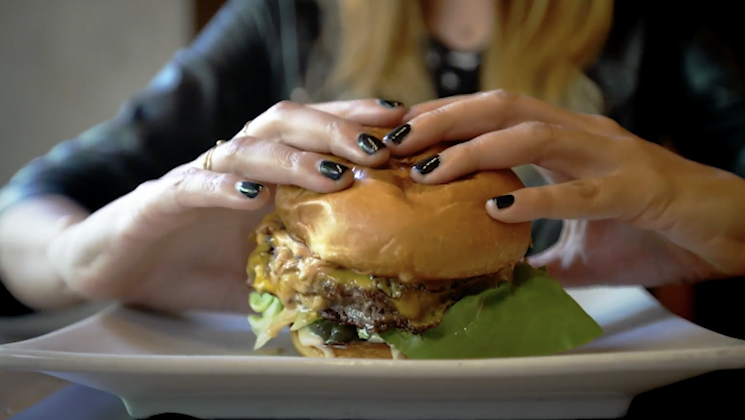
1.2H Microbes can make: Artificial Meat
Company: Impossible Foods
Location: Redwood City, CA
Summary: Impossible Foods figured out how to make artificial meat that tastes like real meat. They engineered a bacteria to make the key red ingredient, called heme.
© 2022 by The Regents of the University of California.
Notes:
Animal agriculture is a leading contributor to climate change. Changing diets from animal protein to plant protein would lead to a dramatic reduction in greenhouse gas emissions.Heme is the only ingredient in the impossible burger that is made by microbes. Other key ingredients in the impossible burger are protein from soy, fat from sunflower and coconut oils, and binders that help hold it together.

Slide 12
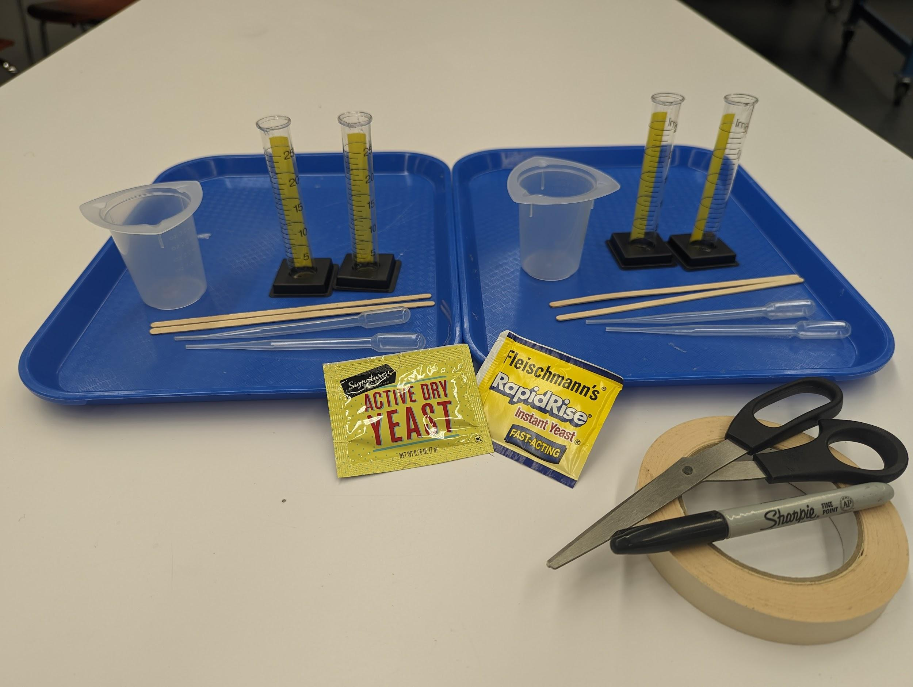
1.3A Activity Materials
© 2022 by The Regents of the University of California.

Slide 13
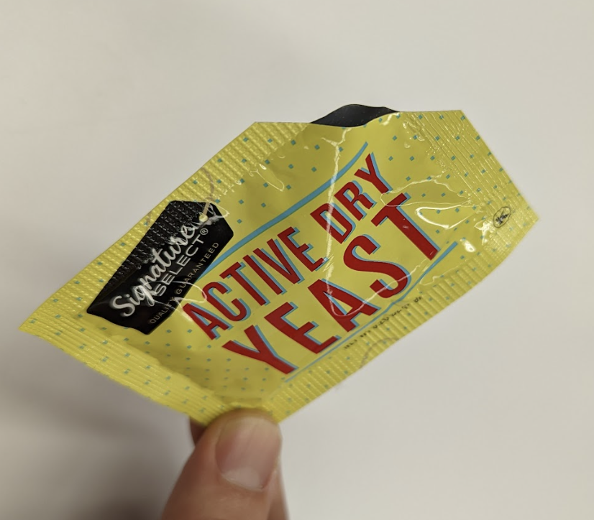
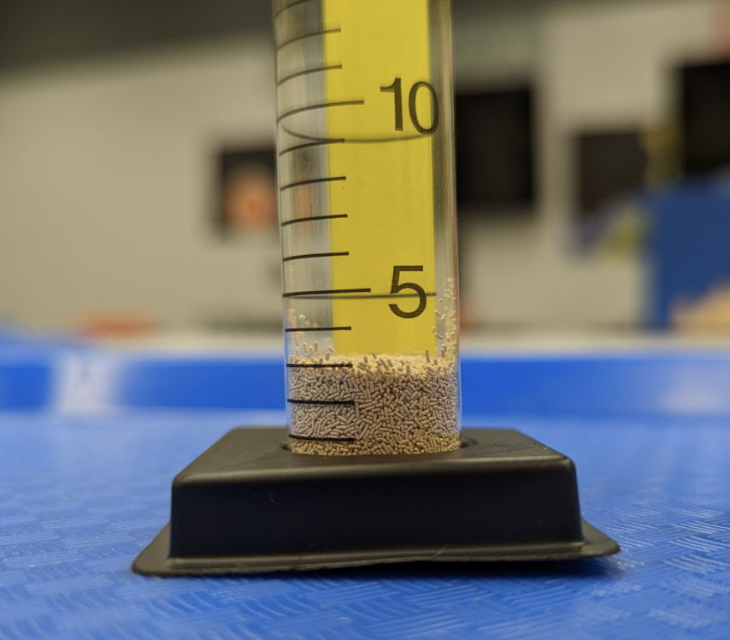
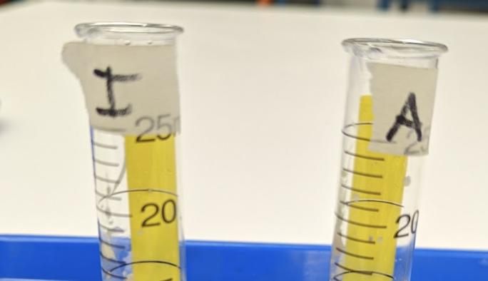
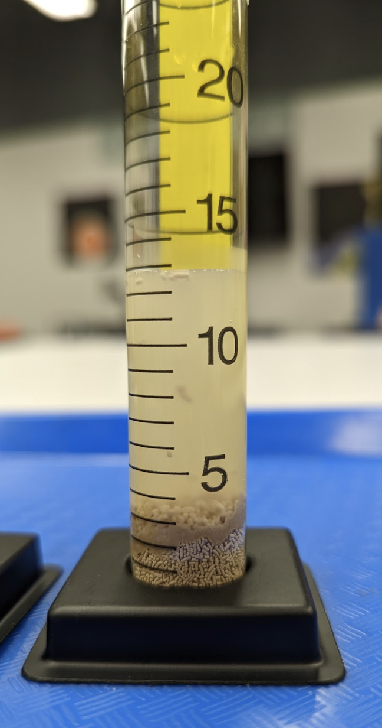
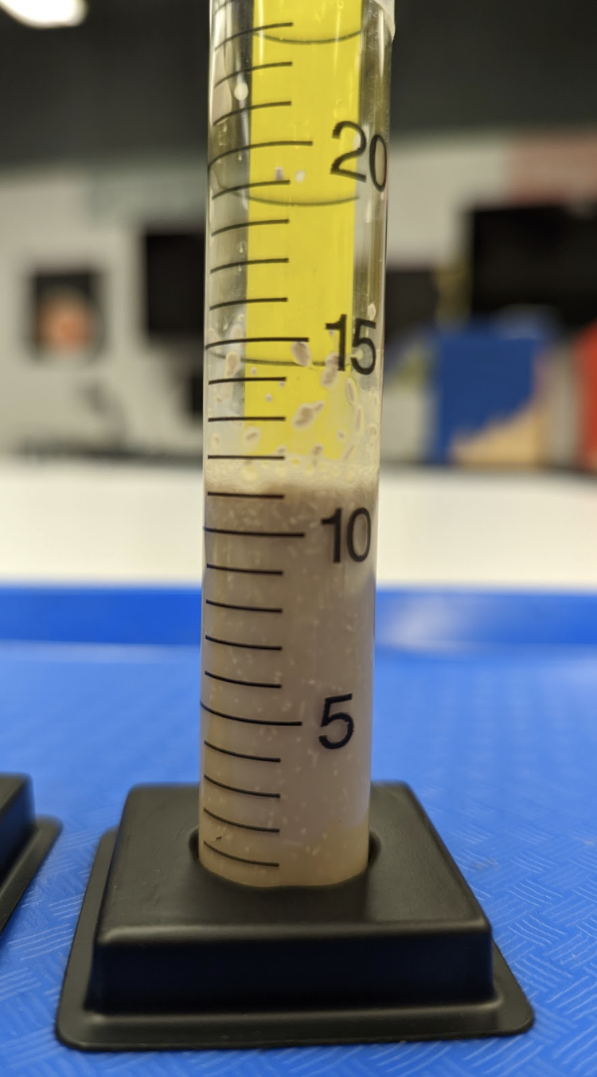
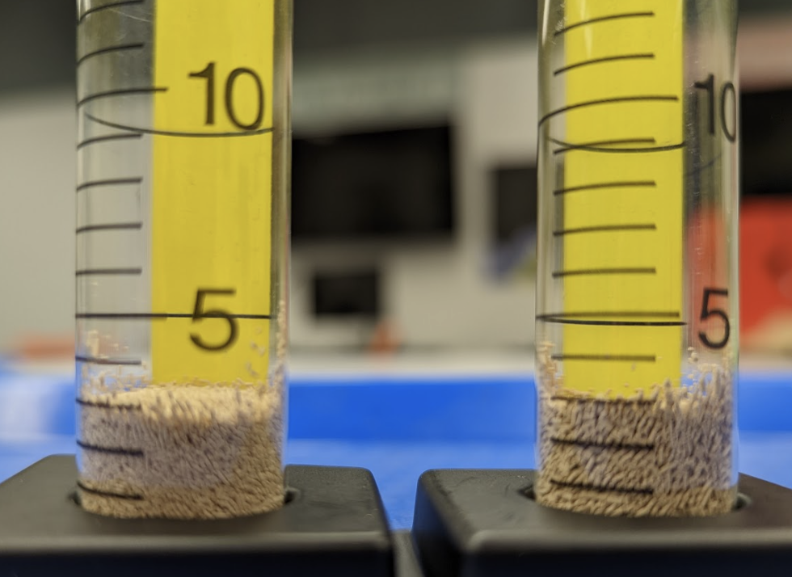
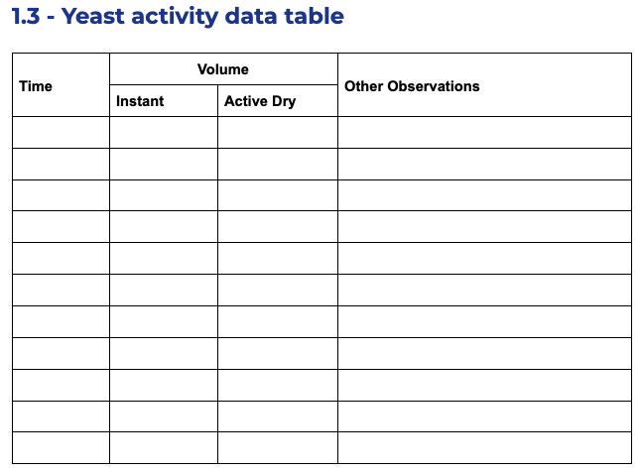
1.3B Activity Instructions
1
2
3
Label cylinders “I” or “A” for Instant & Active Dry.
Open the corner of one yeast packet.
Fill the appropriate graduated cylinder to the 3 mL line.
4
5
6
7
Switch yeast types with your partner pair and repeat steps 2 & 3 with the other yeast packet.
To both cylinders at the same time, add warm sugar water to the 13 mL line.
Stir the yeast and water to mix completely.
Record observations every 1 minute.

Slide 14
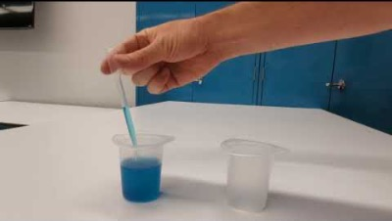
1.3C How to Use a Transfer Pipette
Steps to fill the pipette
Gently squeeze the bulb
Place the tip in the liquid
Slowly release the pressure on the bulb
Lift the pipette out of the liquid (and keep it vertical)
Steps to dispense the liquid
Move the tip over where you want the liquid to go
Gently squeeze the bulb
© 2022 by The Regents of the University of California.

Slide 15
1.3D Data Table
Time | Volume |  | Other Observations
 | Instant | Active Dry
9:00 am | 12 mL | 12 mL | Mixed with water
© 2022 by The Regents of the University of California.

Slide 16
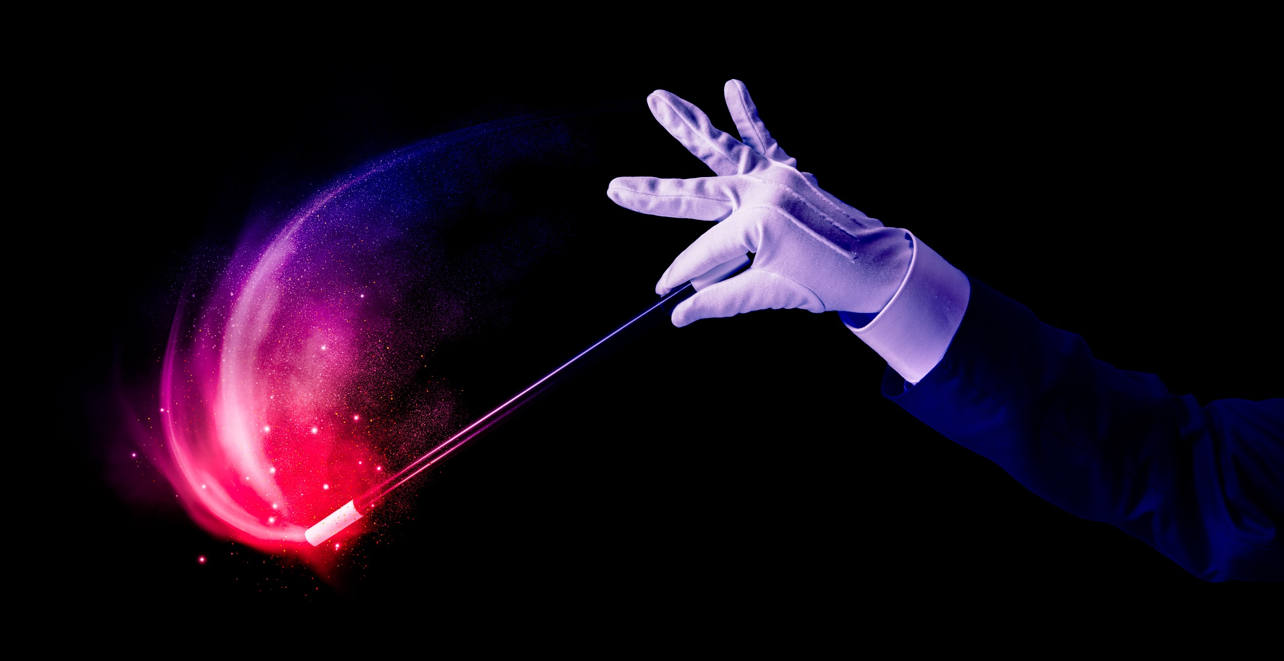
1.4A - Biotech Science Wand
If you had a “biotech science wand,” what would you use it for?
© 2022 by The Regents of the University of California.

Slide 17
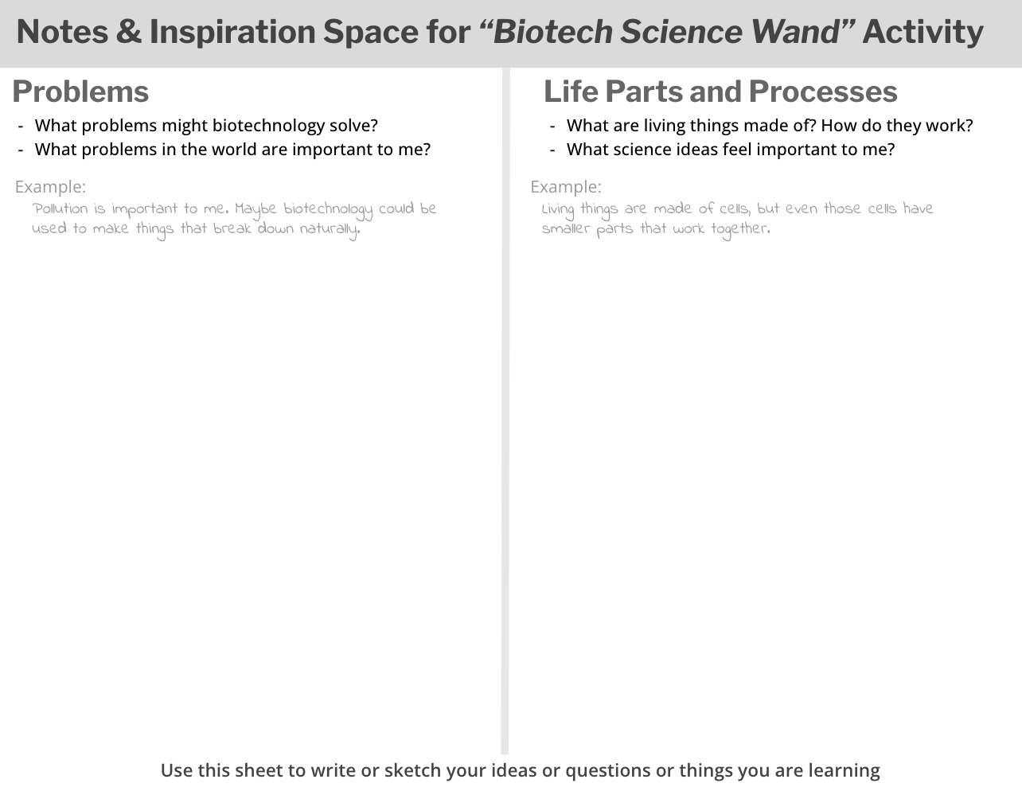
1.4B Graphic Organizer
© 2022 by The Regents of the University of California.

Slide 18
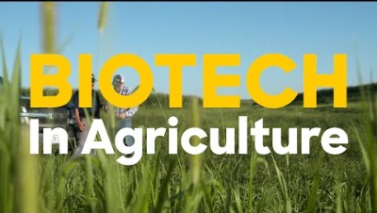
1.5A Biotech in Agriculture: Pivot Bio

Slide 19
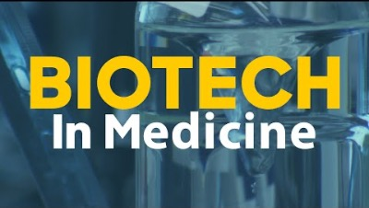
1.5B Biotech in Medicine: Bayer

Slide 20
Lesson 3

Slide 21
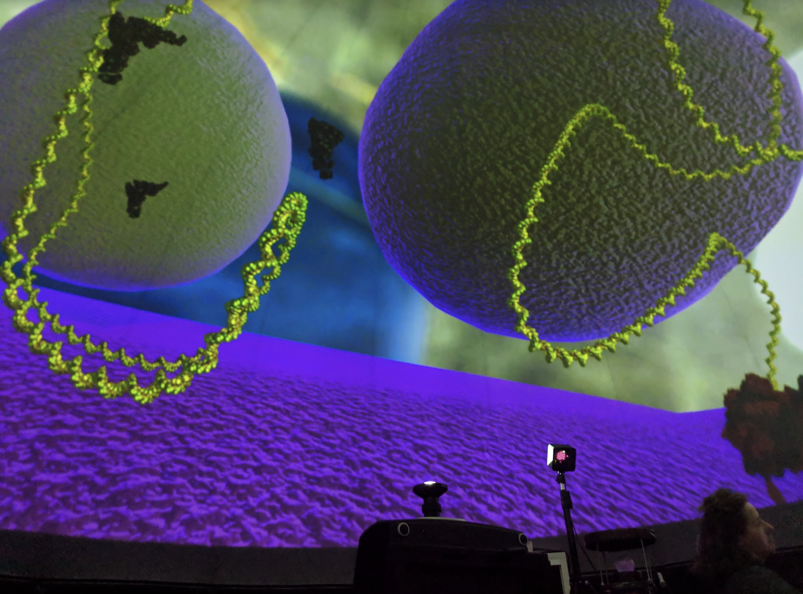
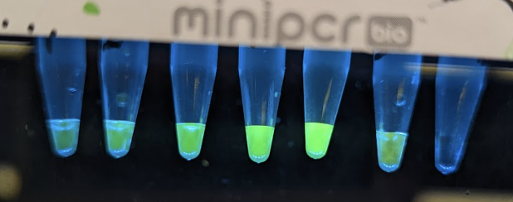
3.1 - Warm-Up
What do you remember about biotech from your trip to The Lawrence?
Update your graphic organizer with information about Lifes Parts and Processes or with ideas about Problems that could be solved with biotechnology.
© 2022 by The Regents of the University of California.

Slide 22
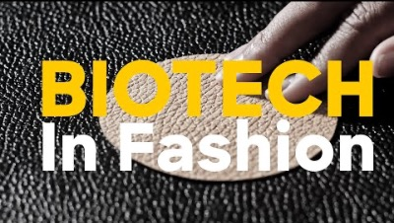
3.2A Bolt Threads video

Slide 23
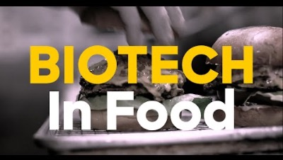
3.2B Impossible Foods video

Slide 24
3.3 - Biotech Science Wand
If you had a “biotech science wand,” what would you use it for?
© 2022 by The Regents of the University of California.

