Slide 1
The Power of CRISPR

Slide 2
Limited License to Modify
LIMITED LICENSE TO MODIFY. These PowerPoint® slides may be modified only by teachers currently teaching the CRISPR course to customize the unit to match their students’ learning levels or to insert additional teaching aides. Modified slides may be used only by teachers in their classrooms, with these same restrictions. Modified slides may not be taken out of the classroom or distributed to any non-student person or organization. Except for use with students in the classroom, modified slides may not be published in printed or electronic form, including posting on the Internet. Only text may be modified: photographs and illustrations on the slides may not be modified in any way except to change their size.
DISCLAIMER OF WARRANTY. THE REGENTS OF THE UNIVERSITY OF CALIFORNIA (“University”) MAKE NO REPRESENTATIONS OR WARRANTIES, EXPRESS OR IMPLIED, INCLUDING BUT NOT LIMITED TO THE IMPLIED WARRANTIES OF MERCHANTABILITY AND FITNESS FOR A PARTICULAR PURPOSE. University will not be liable for any costs, damages, fees or other liability, nor for any direct, indirect, special, incidental or consequential damages (including lost profits) with respect to any claims by the purchaser or user of CRISPR or any third party on account of or arising from the use or modifications to the slides. Client acknowledges and accepts that University services are provided on an as-is basis.

Slide 3
Article: Sickle Cell Disease: Discussion Questions
Review the diagram on the second page:
How does the mutation in the hemoglobin beta gene lead
to the trait of sickle-shaped red blood cells?
Compare the diagram and the model you created.
  How are they similar?
  How are they different?

Slide 4
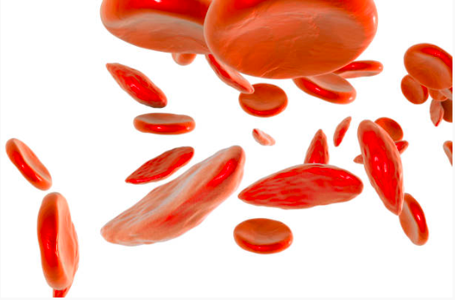
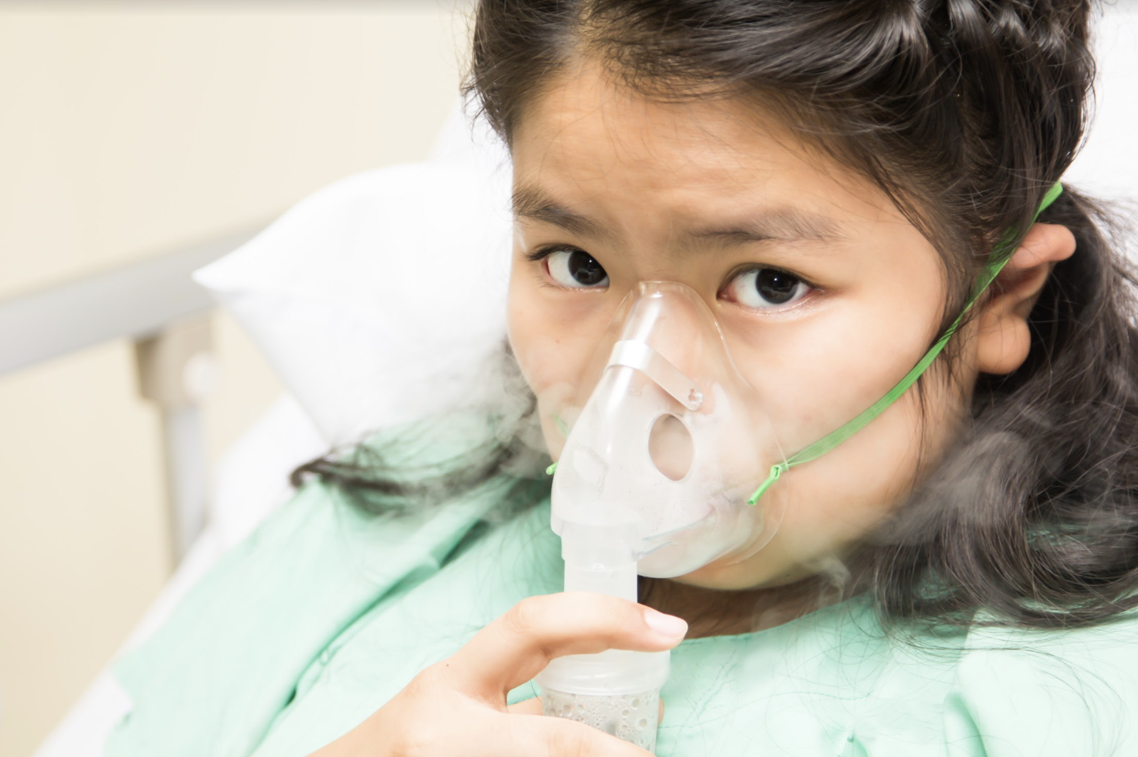
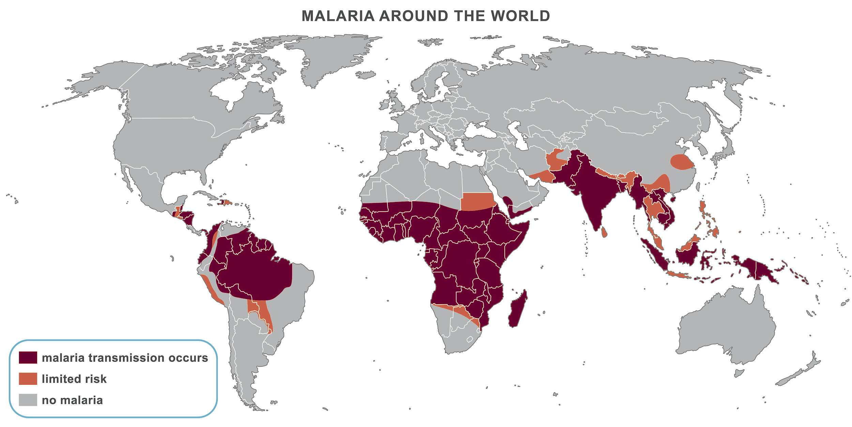
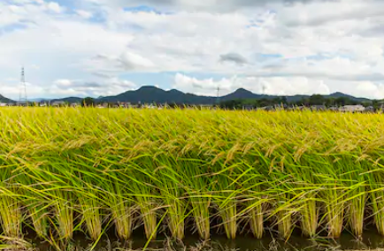
Articles: Ethics of CRISPR
Treating Sickle Cell Disease
Preventing Cystic Fibrosis
Fighting Malaria
Disease-Resistant Rice
Image credits: Patient: tiverylucky/Shutterstock.com; Rice field: Soichiro/Shutterstock.com
Notes:
Top left, bottom left, top right, bottom right
CRISPR_COM_037, CRISPR_COM_038, CRISPR_COM_039, CRISPR_COM_040

Slide 5
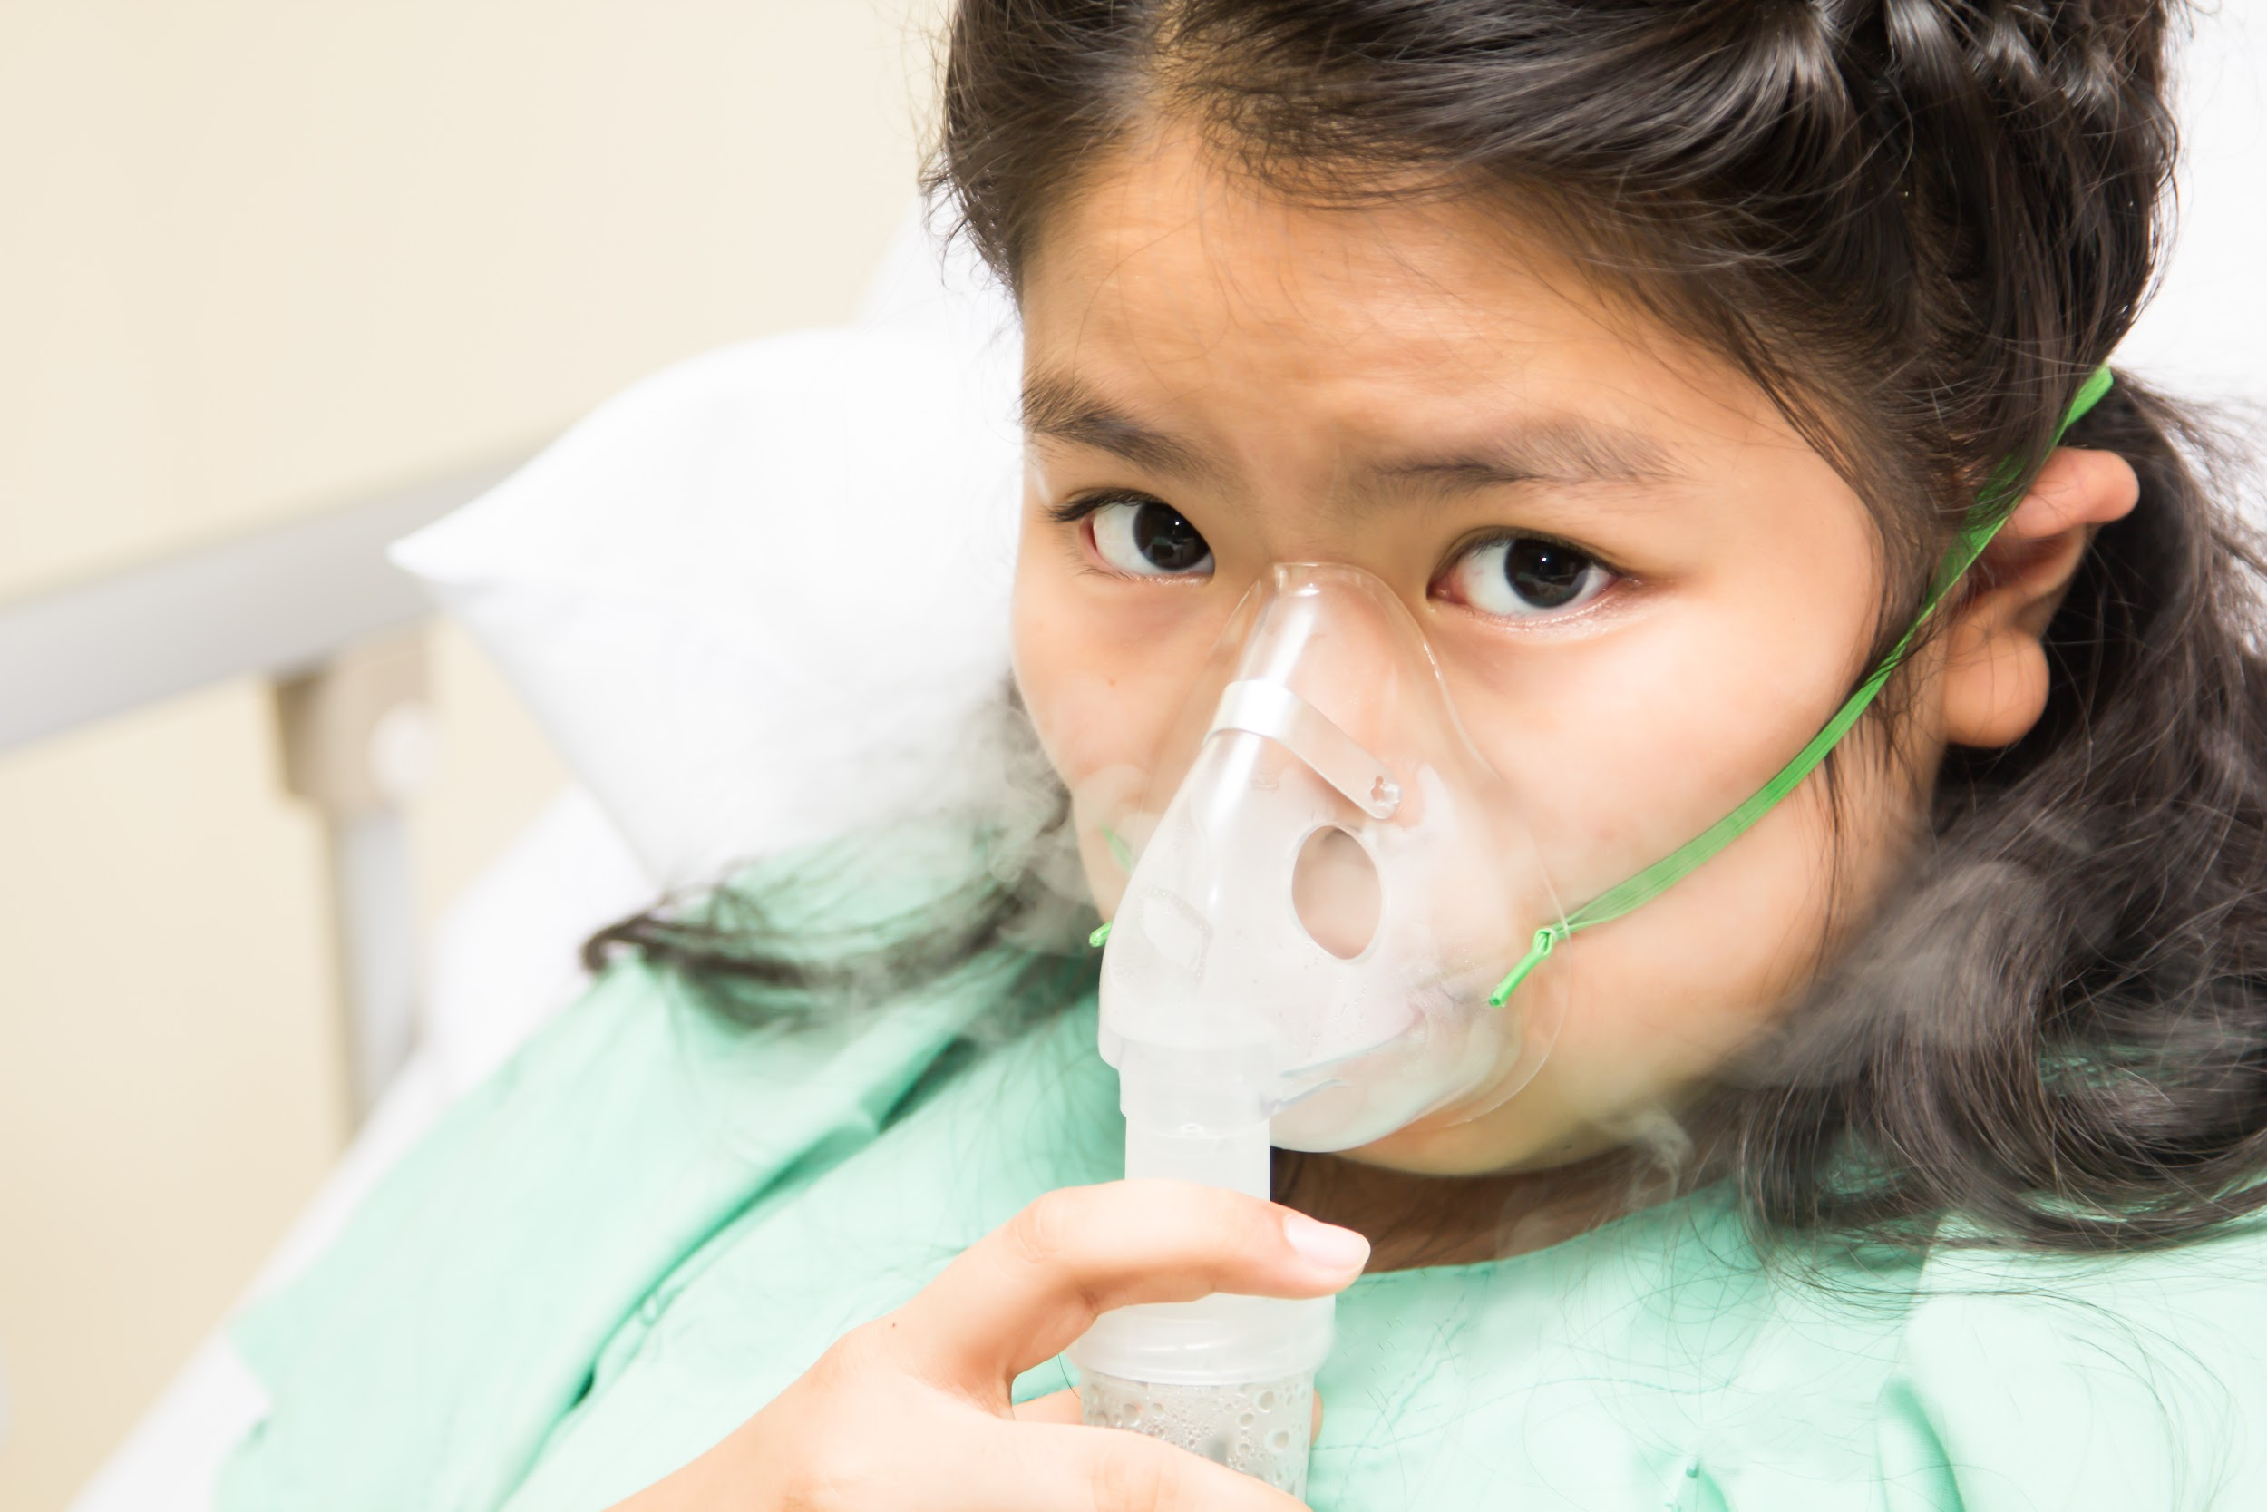
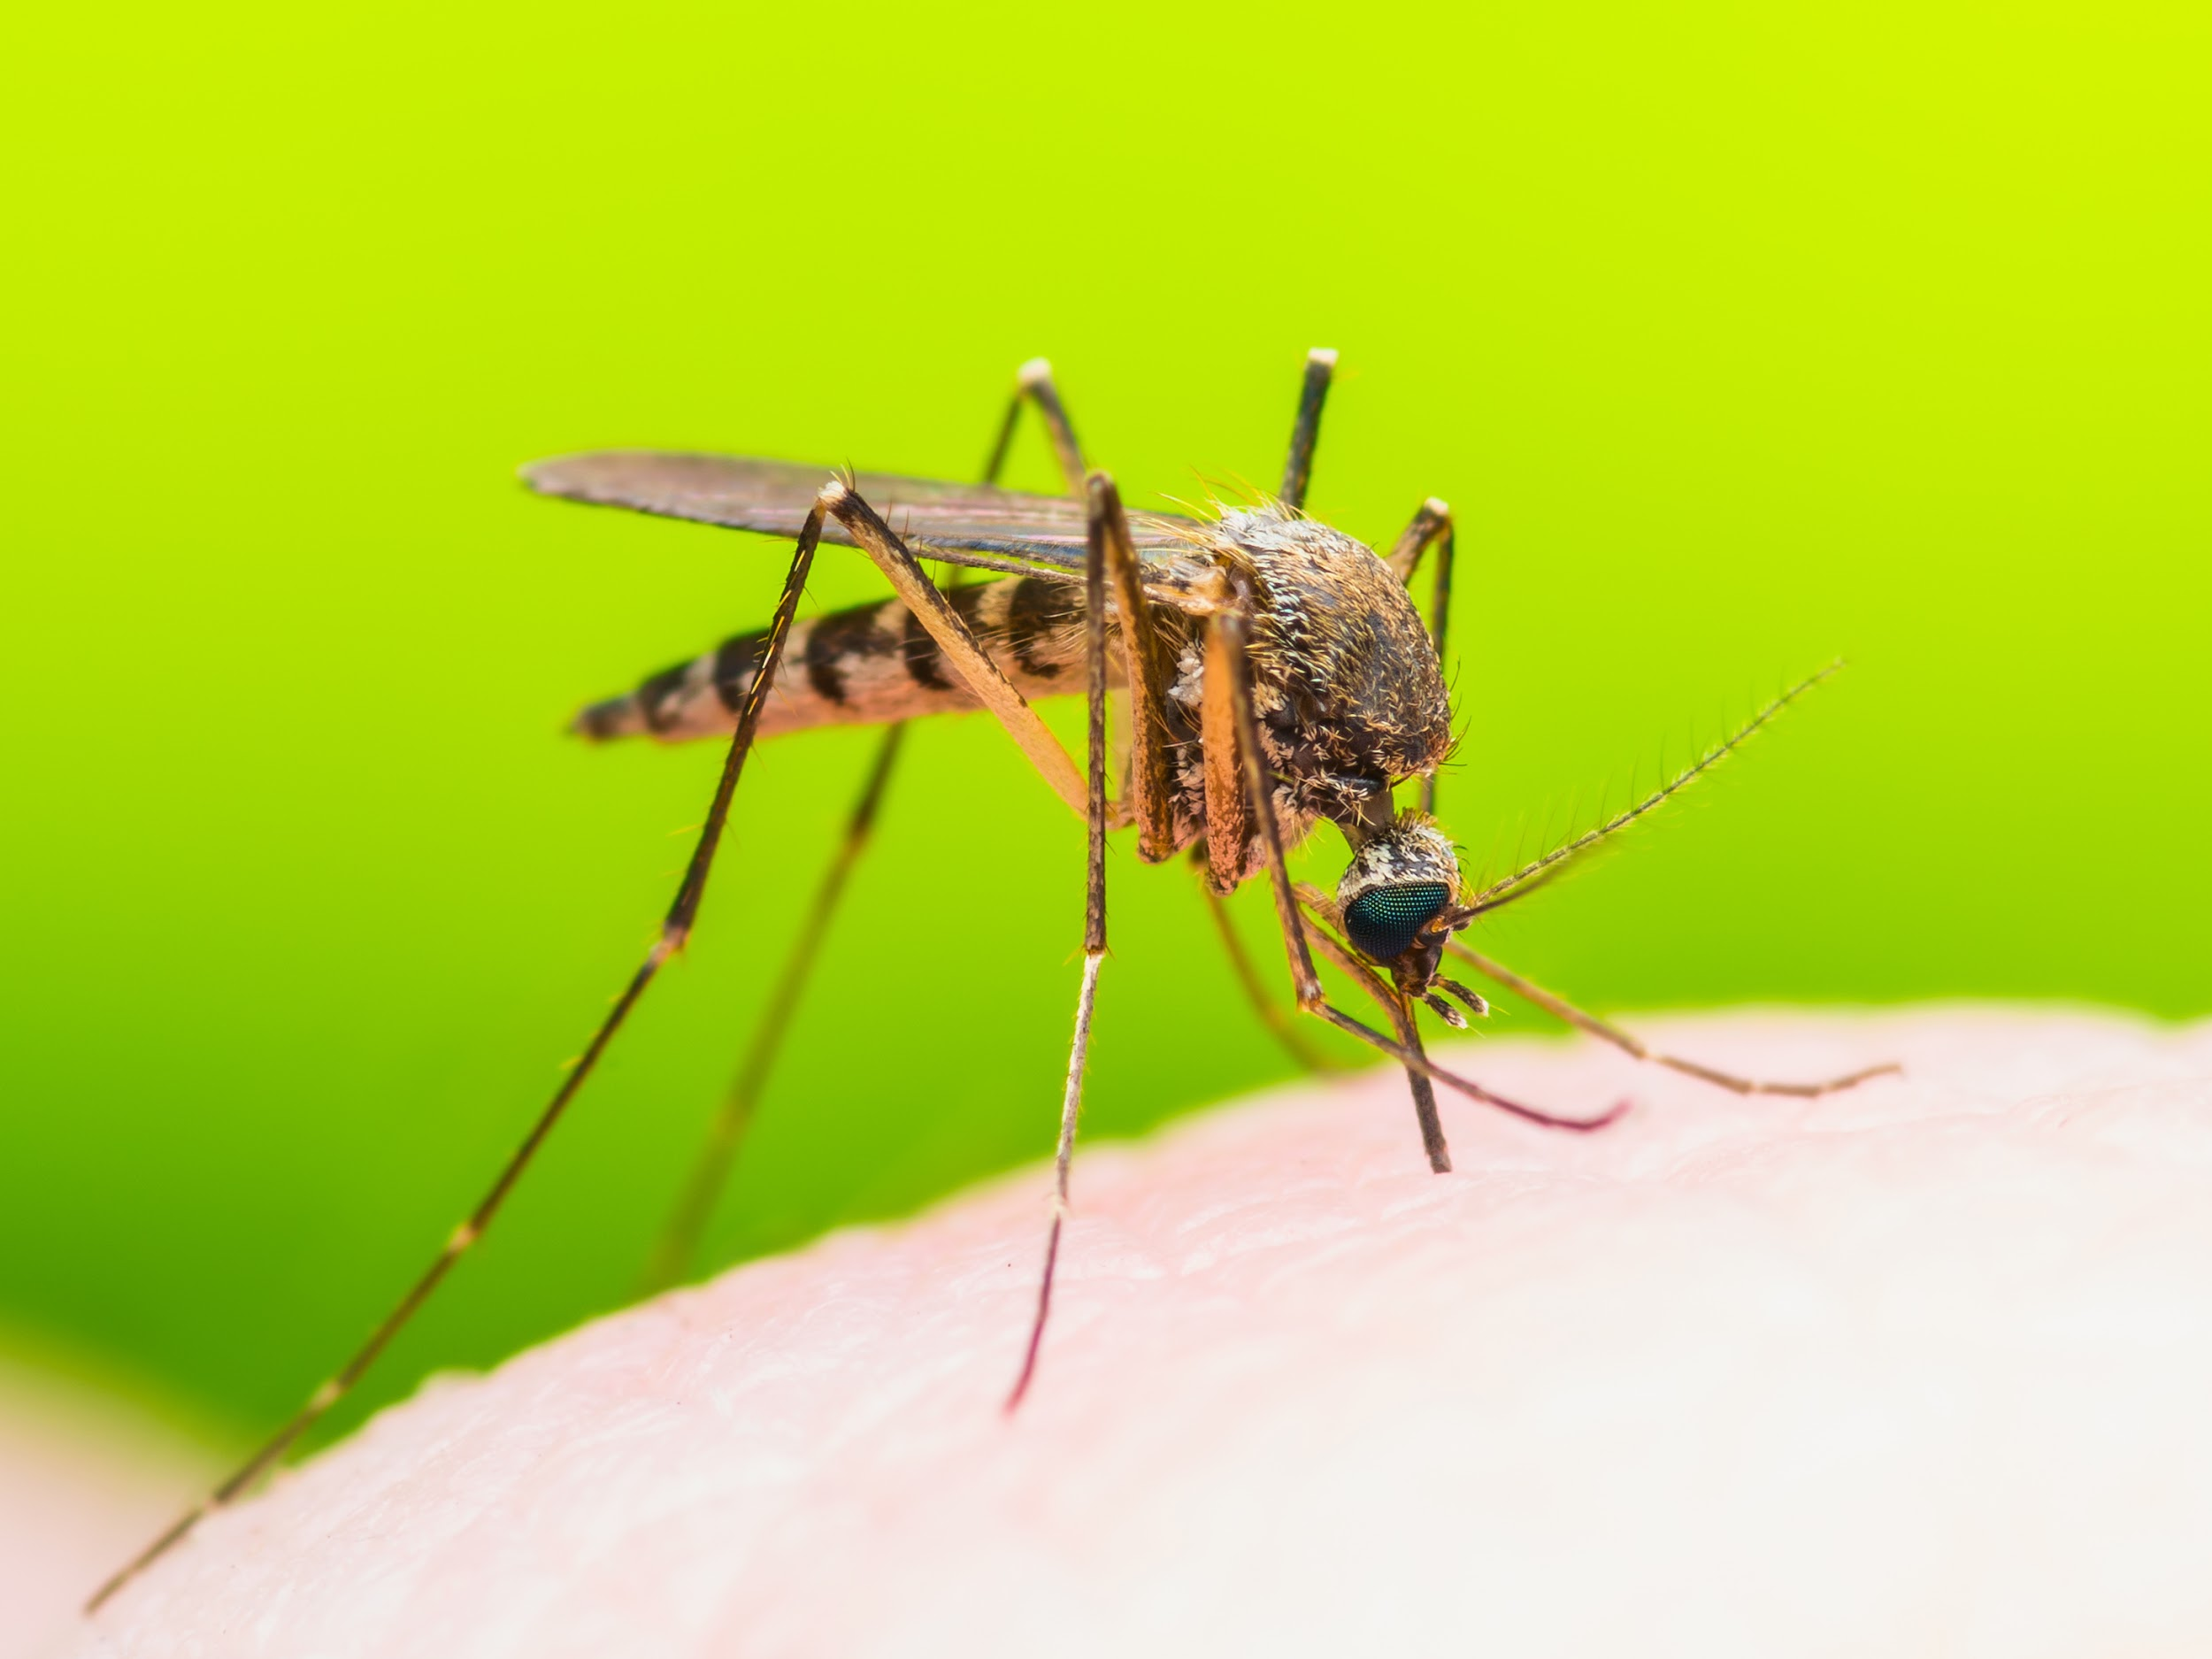
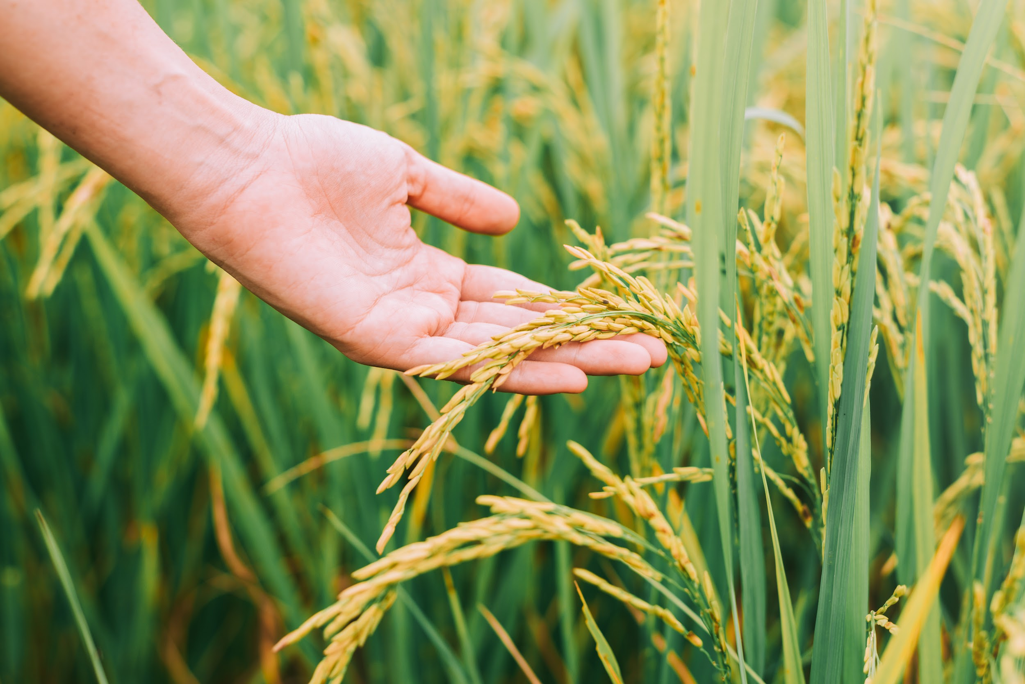
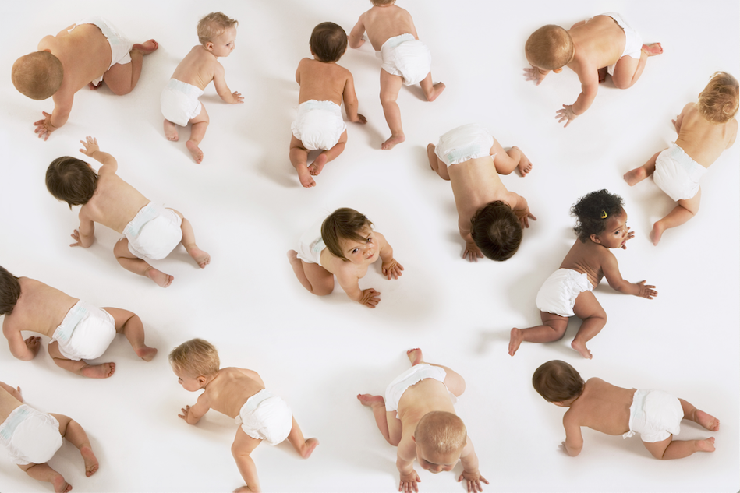
Using CRISPR
Under What Circumstances Should CRISPR Be Used?
Image credits: Patient: tiverylucky/Shutterstock.com; Mosquito: nechaevkon/Shutterstock.com;
Hand on grain: GrooveZ/Shutterstock.com; Babies: sirtravelalot/Shutterstock.com
Notes:
Top left, bottom left, top right, bottom right
CRISPR_COM_039, CRISPR_COM_041, CRISPR_COM_042, CRISPR_COM_043

Slide 6
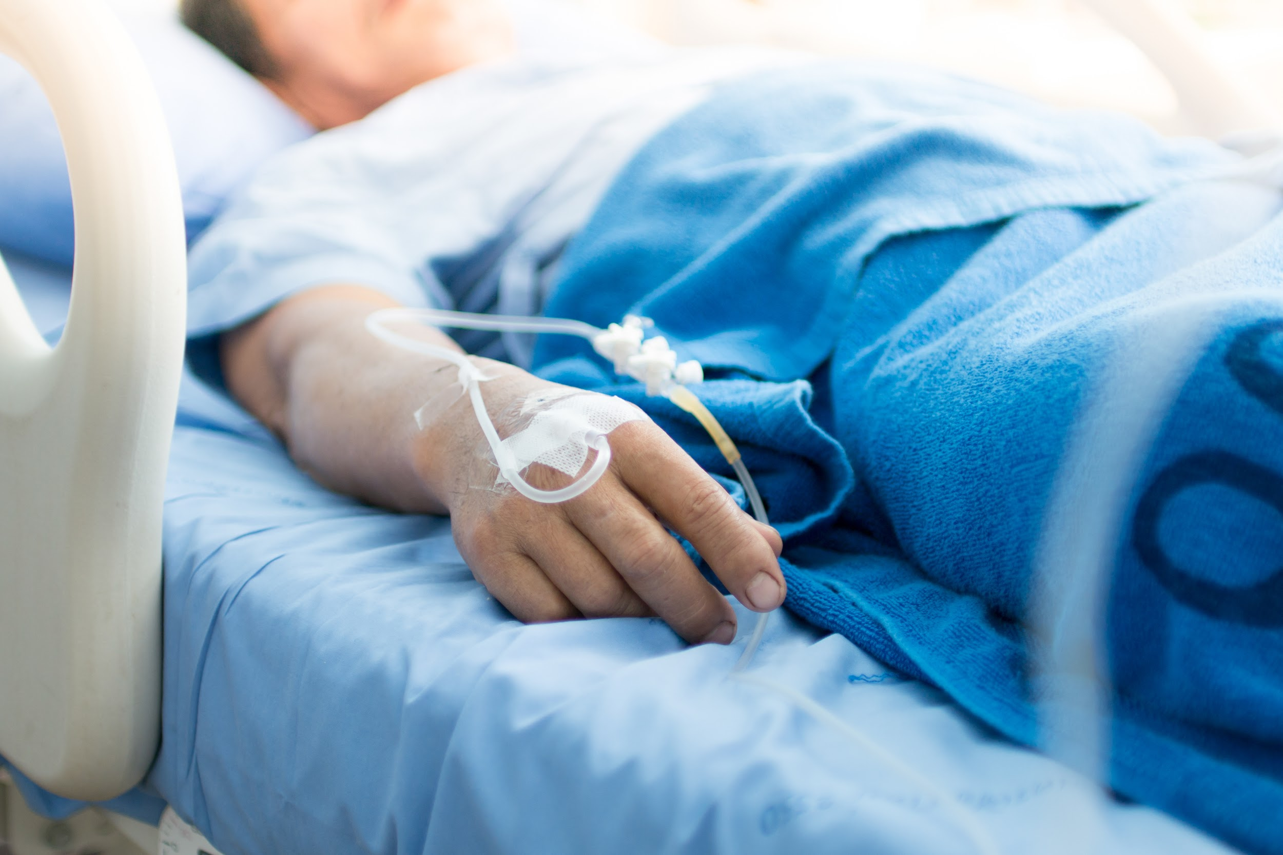
Treating Sickle Cell Disease
Should CRISPR be used to treat humans with diseases?
What is the biggest risk?
What is the biggest benefit?
Do the risks outweigh the benefits, or do the benefits outweigh
the risks?
Image credits: Patient with mask: tiverylucky/Shutterstock.com; Patient in bed: Thaiview/Shutterstock.com
Notes:
CRISPR_COM_039, CRISPR_COM_044

Slide 7
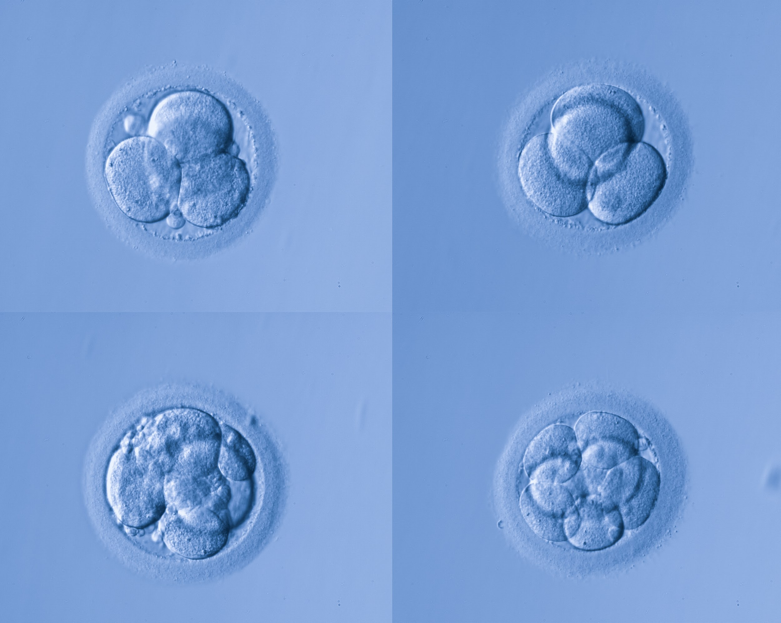
Preventing Cystic Fibrosis
Should CRISPR be used to edit genes in embryos, sperm, or eggs?
What is the biggest risk?
What is the biggest benefit?
Do the risks outweigh the benefits, or do the benefits outweigh
the risks?
Image credits: Human egg cells: 895Studio/Shutterstock.com; Babies: sirtravelalot/Shutterstock.com
Notes:
CRISPR_COM_045, CRISPR_COM_043

Slide 8
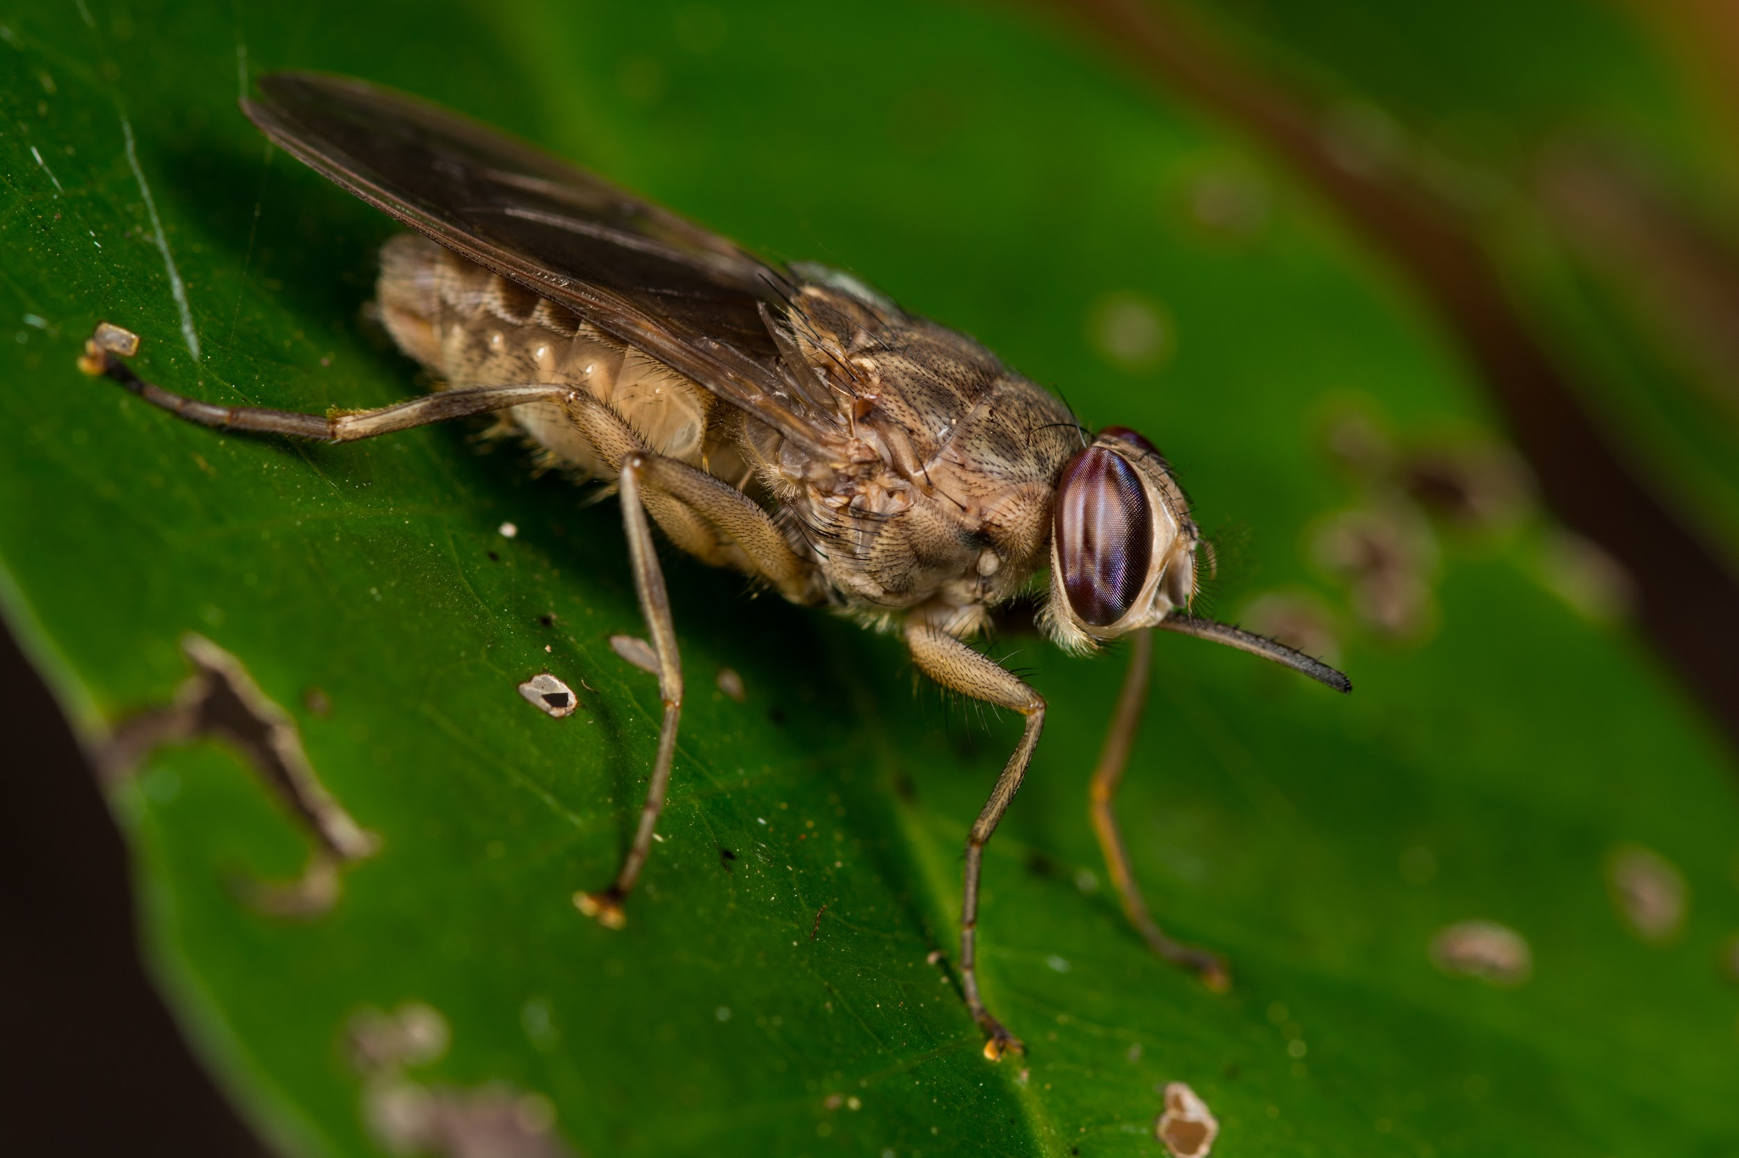
Fighting Malaria
Should CRISPR be used to edit genes in insects to prevent the spread of disease?
What is the biggest risk?
What is the biggest benefit?
Do the risks outweigh the benefits, or do the benefits outweigh the risks?
Image credits: Mosquito: nechaevkon/Shutterstock.com; Tse tse fly: Jaco Visser/Shutterstock.com
Notes:
CRISPR_COM_042, CRISPR_COM_046
Left: CRISPR_FT_007
Right: CRISPR_FT_012
Entire slide: CRISPR_FT_210
https://www.shutterstock.com/image-photo/yellow-fever-malaria-zika-virus-infected-1038408295?src=hPItT4Sw3Cn291eDH36Amw-1-21
https://www.shutterstock.com/image-photo/tsetse-fly-glossina-sp-1157378257?src=h9PTRUasgakfH1gzxBoYcg-1-0

Slide 9
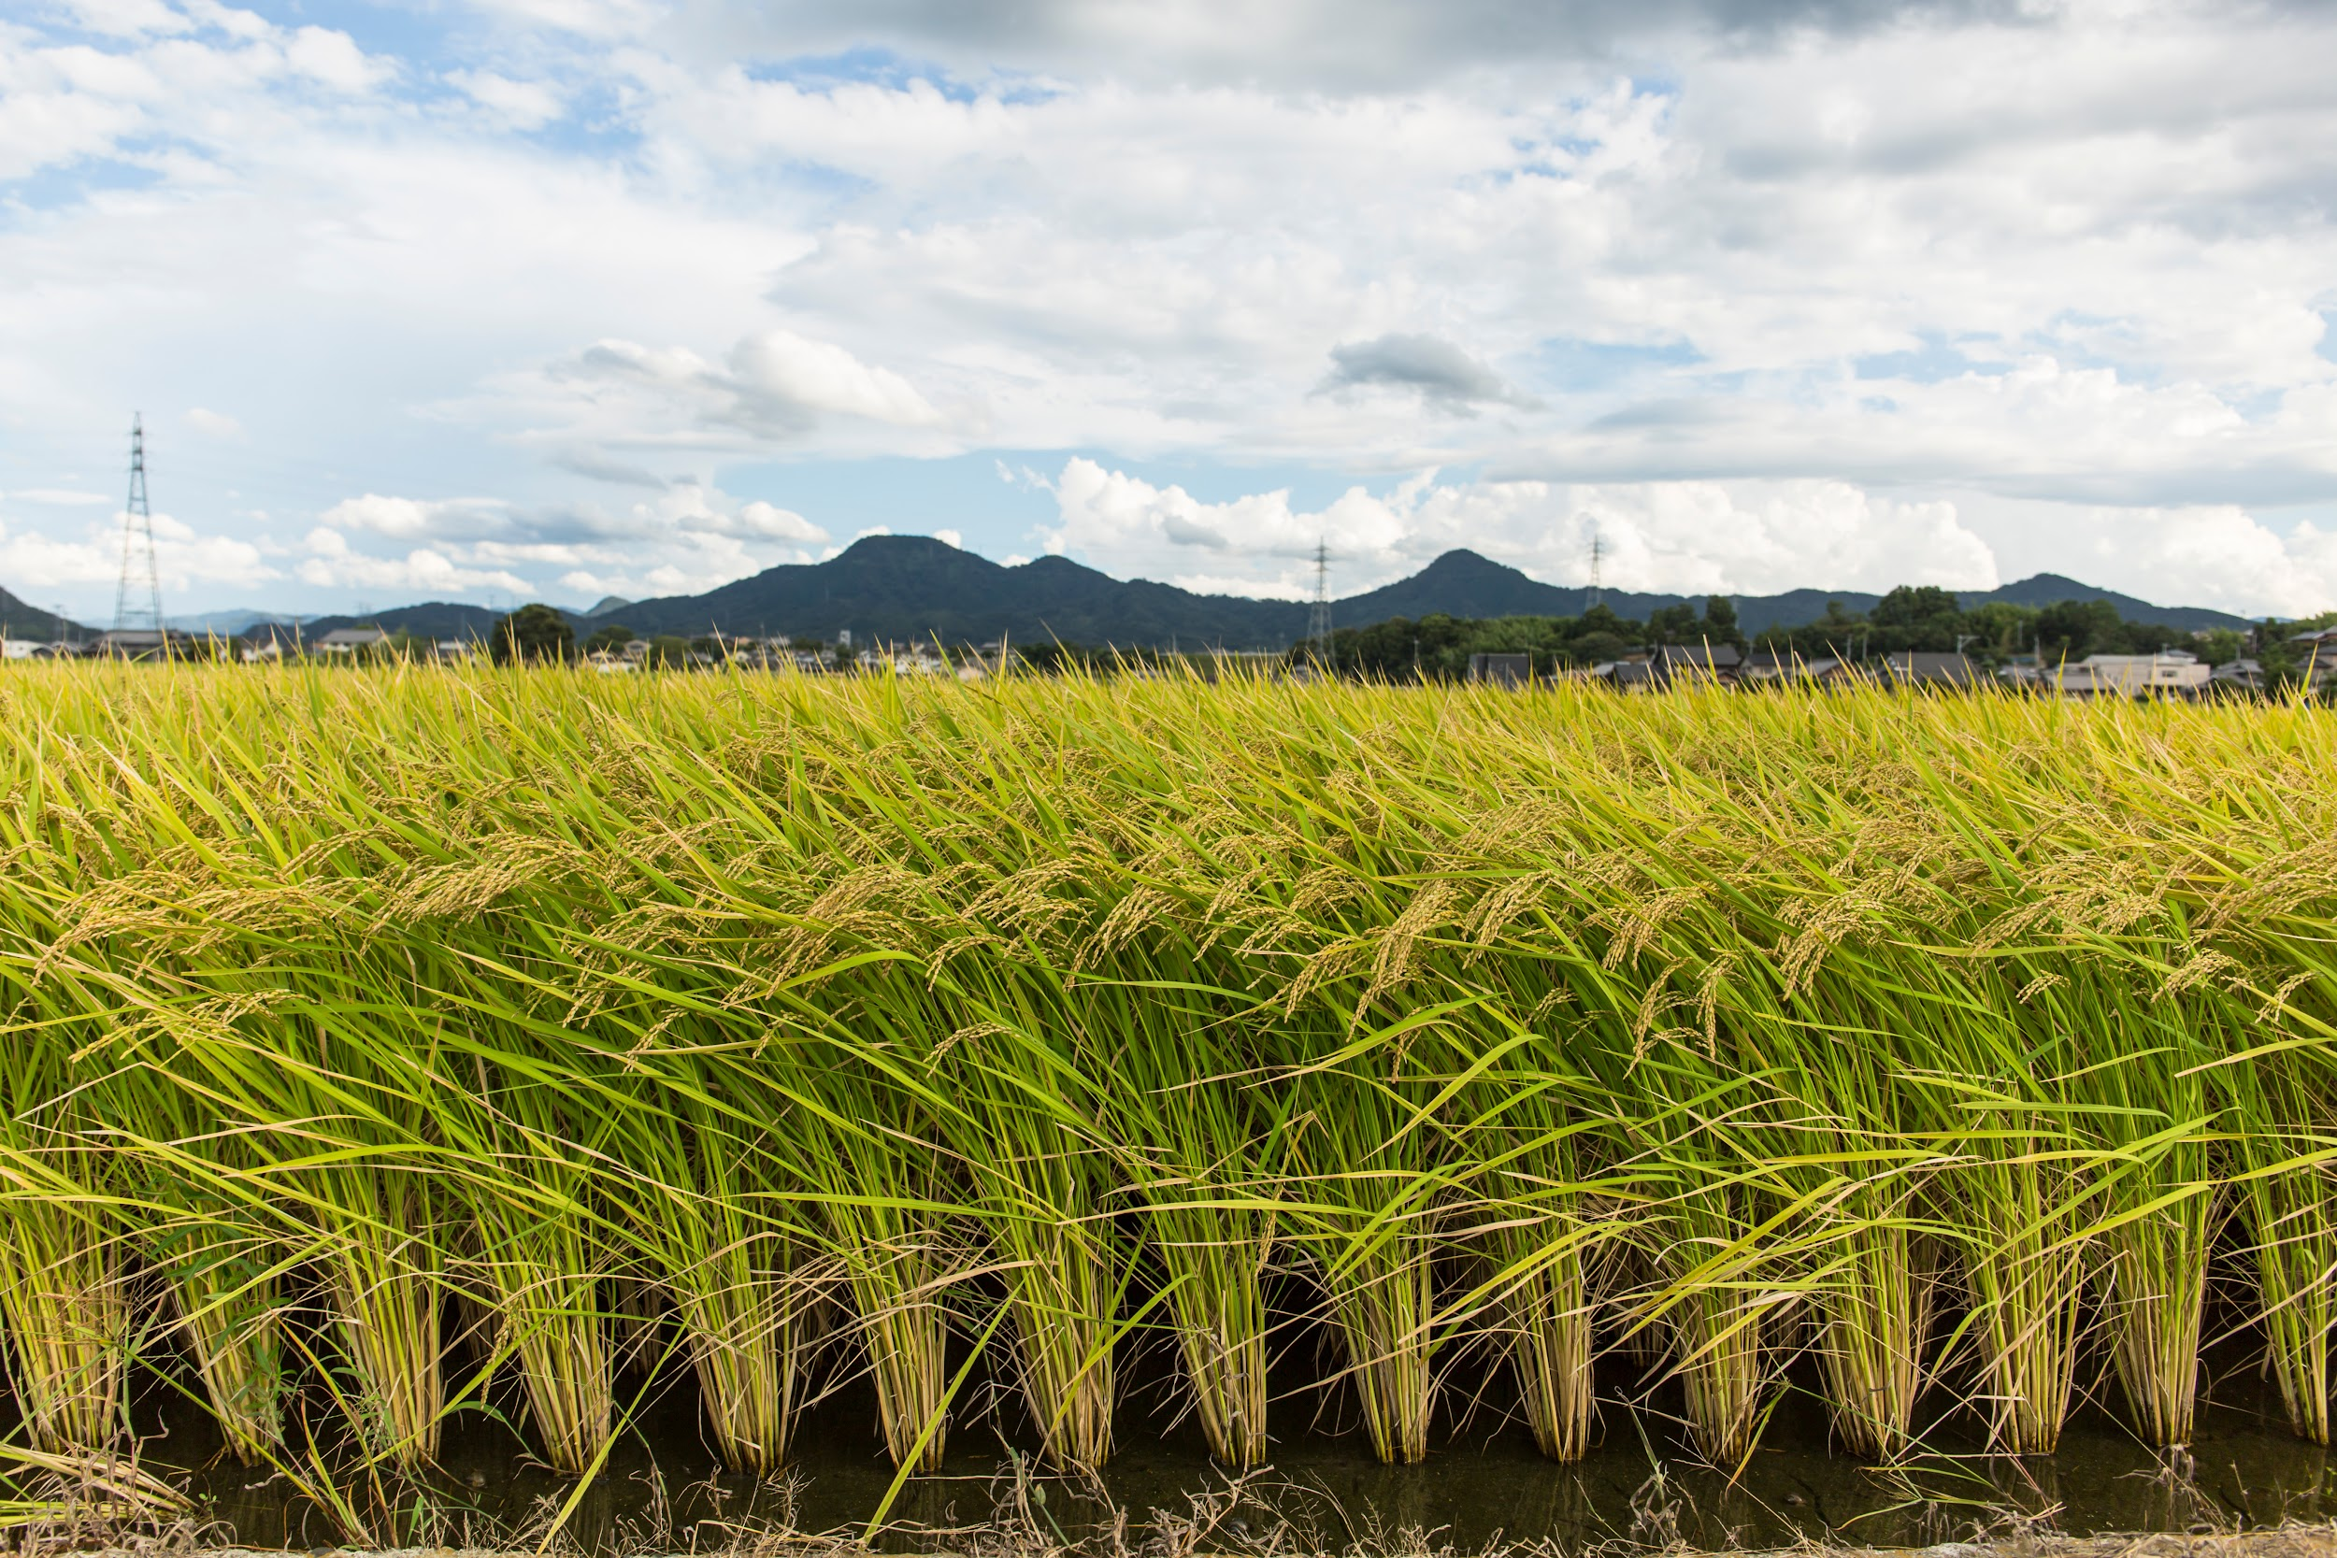
Disease-Resistant Rice
Should CRISPR be used to change the genes of crop plants?
What is the biggest risk?
What is the biggest benefit?
Do the risks outweigh the benefits, or do the benefits outweigh the risks?
Image credits: Hand on grain: GrooveZ/Shutterstock.com; Rice field: Soichiro/Shutterstock.com
Notes:
CRISPR_COM_041, CRISPR_COM_040

